Slide 1
Enhanced Decision Mechanism for RAN Subslicing in Management Closed Control Loop
Marika Kulmar
marika.kulmar@taltech.ee
Ivo Müürsepp
ivo.muursepp@ttu.ee
Muhammad Mahtab Alam
muhammad.alam@taltech.ee
Thomas Johann Seebeck Department of Electronics,
Tallinn University of Technology,
Tallinn, Estonia

Slide 2
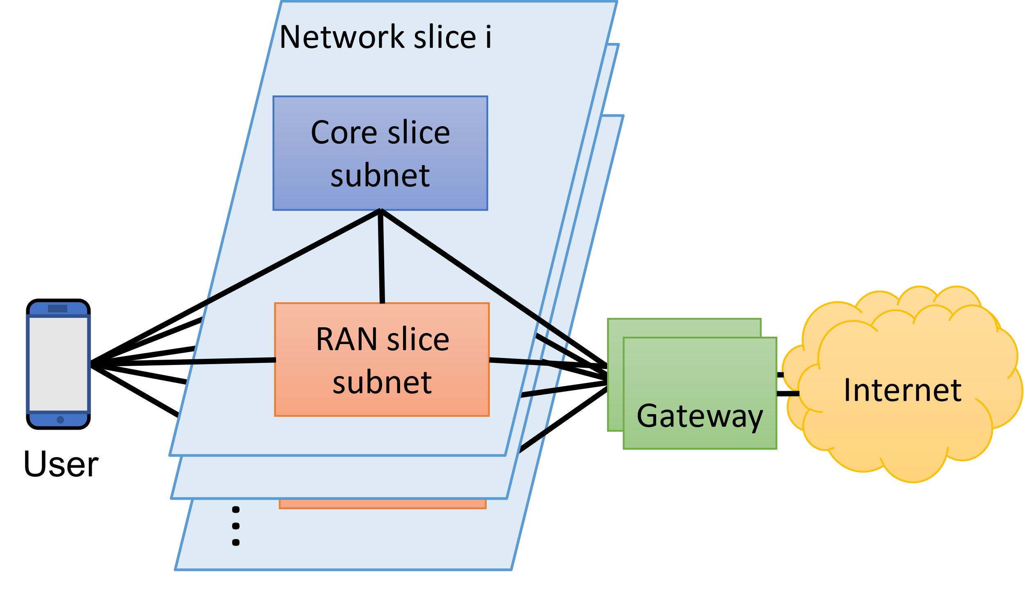
Introduction
Network slicing in 5G-RAN domain
Automatic RAN slice performance management
Radio access technology is 5G New Radio (NR)

Slide 3
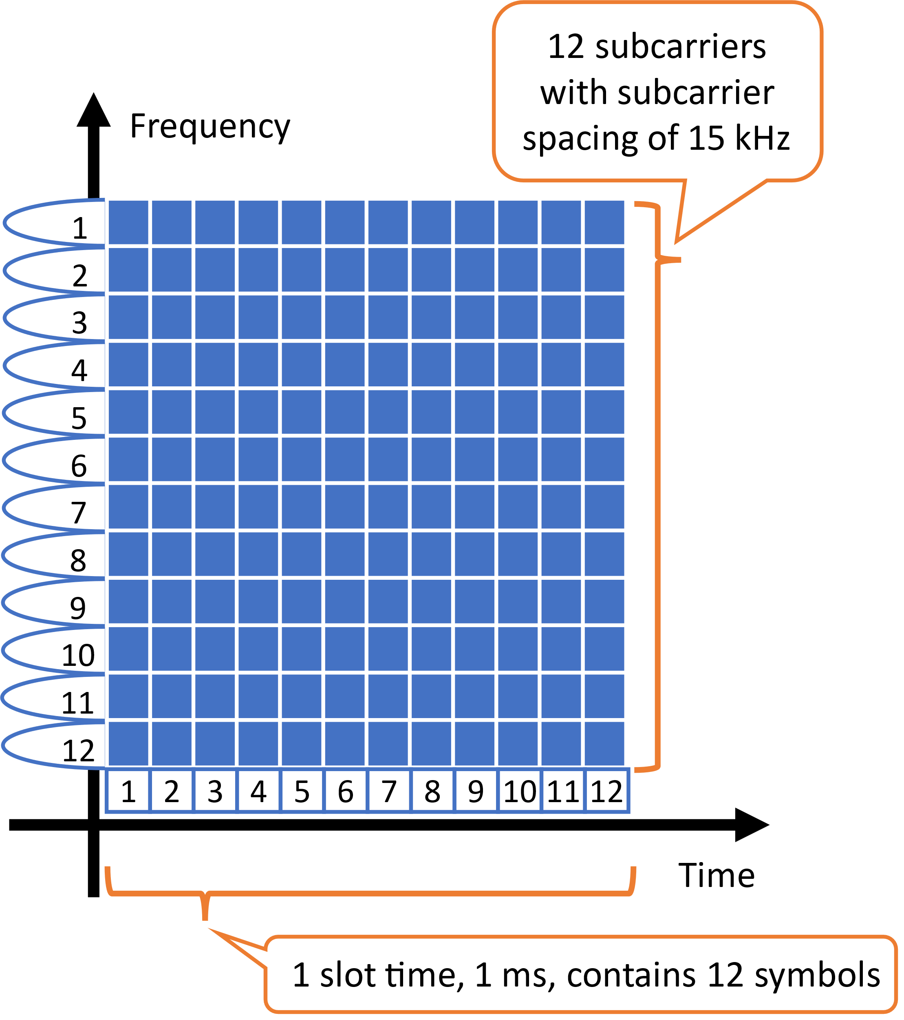
Radio resources
One radio resource unit is called resource block (RB)
We consider
  180 kHz on frequency scale
  1 ms on time scale

Slide 4
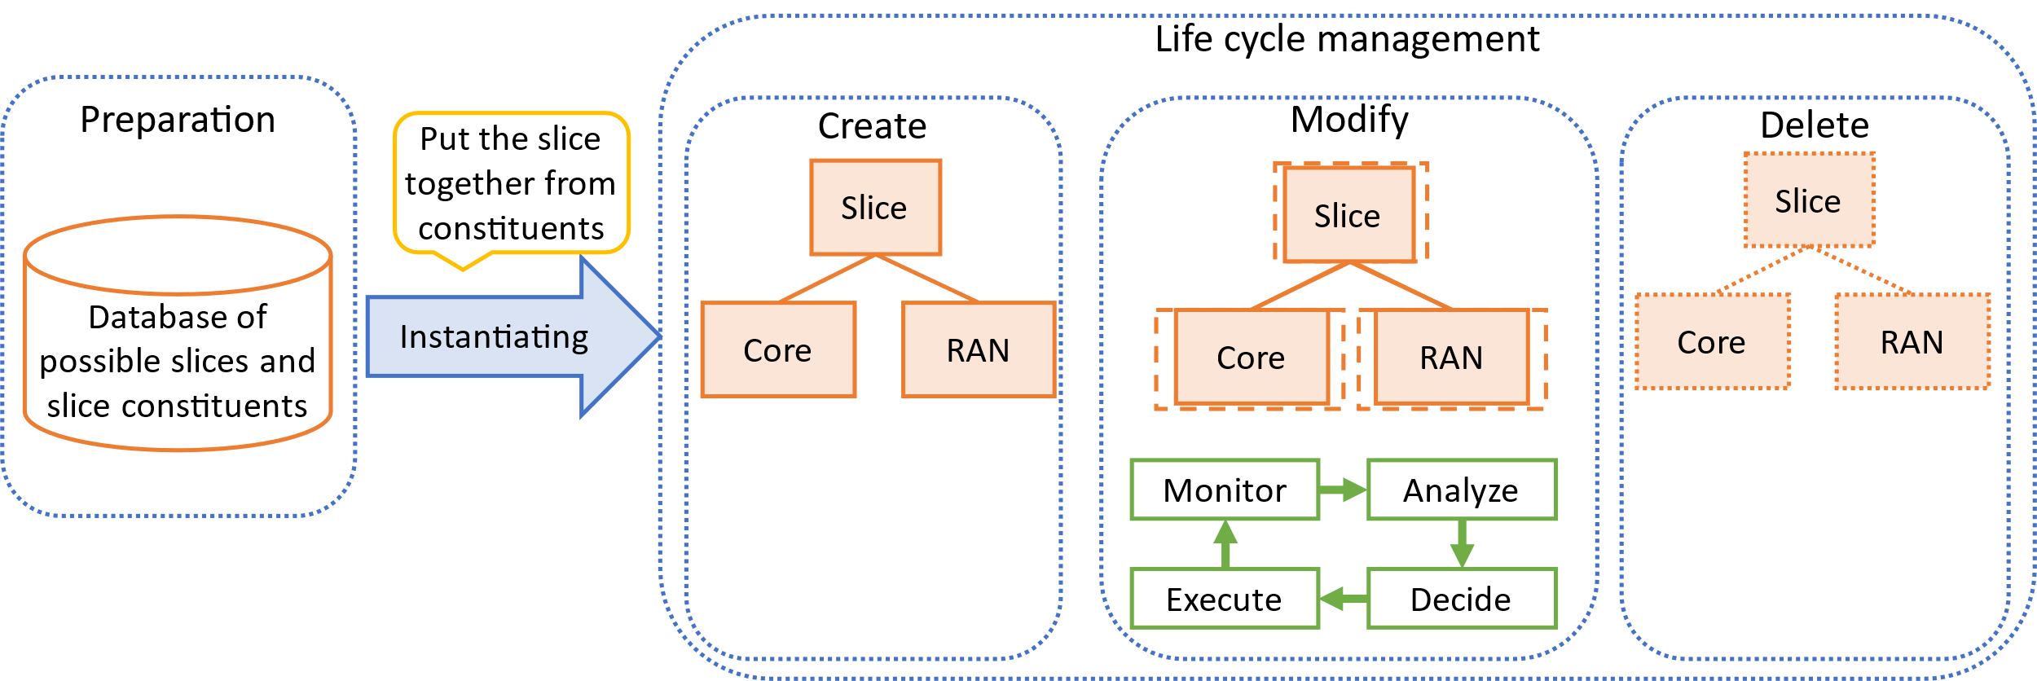
Automatic slice management
Modification phase of life cycle of a slice
Slice performance management
  If slice overload, then add resources;
  If slice underload, then remove resources;
Optimized resource allocation
  For each user equipment (UE) admitted, allocate sufficient resources

Slide 5
Propose subslicing
Subslicing means
  that slice UEs are grouped and
  Slice bandwidth subpartitioned
If subslice performance depends on subslice size then the slice can be subsliced into suitable size to improve slice performace
bandwidth
f, Hz
bandwidth
f, Hz

Slide 6
Management closed control loop
Propose subslicing
In Plan function it is decided whether the slice needs to be split, merged or not changed
Monitor
Analyze
Knowledge
Execute
Plan (Decide)
This presentation

Slide 7
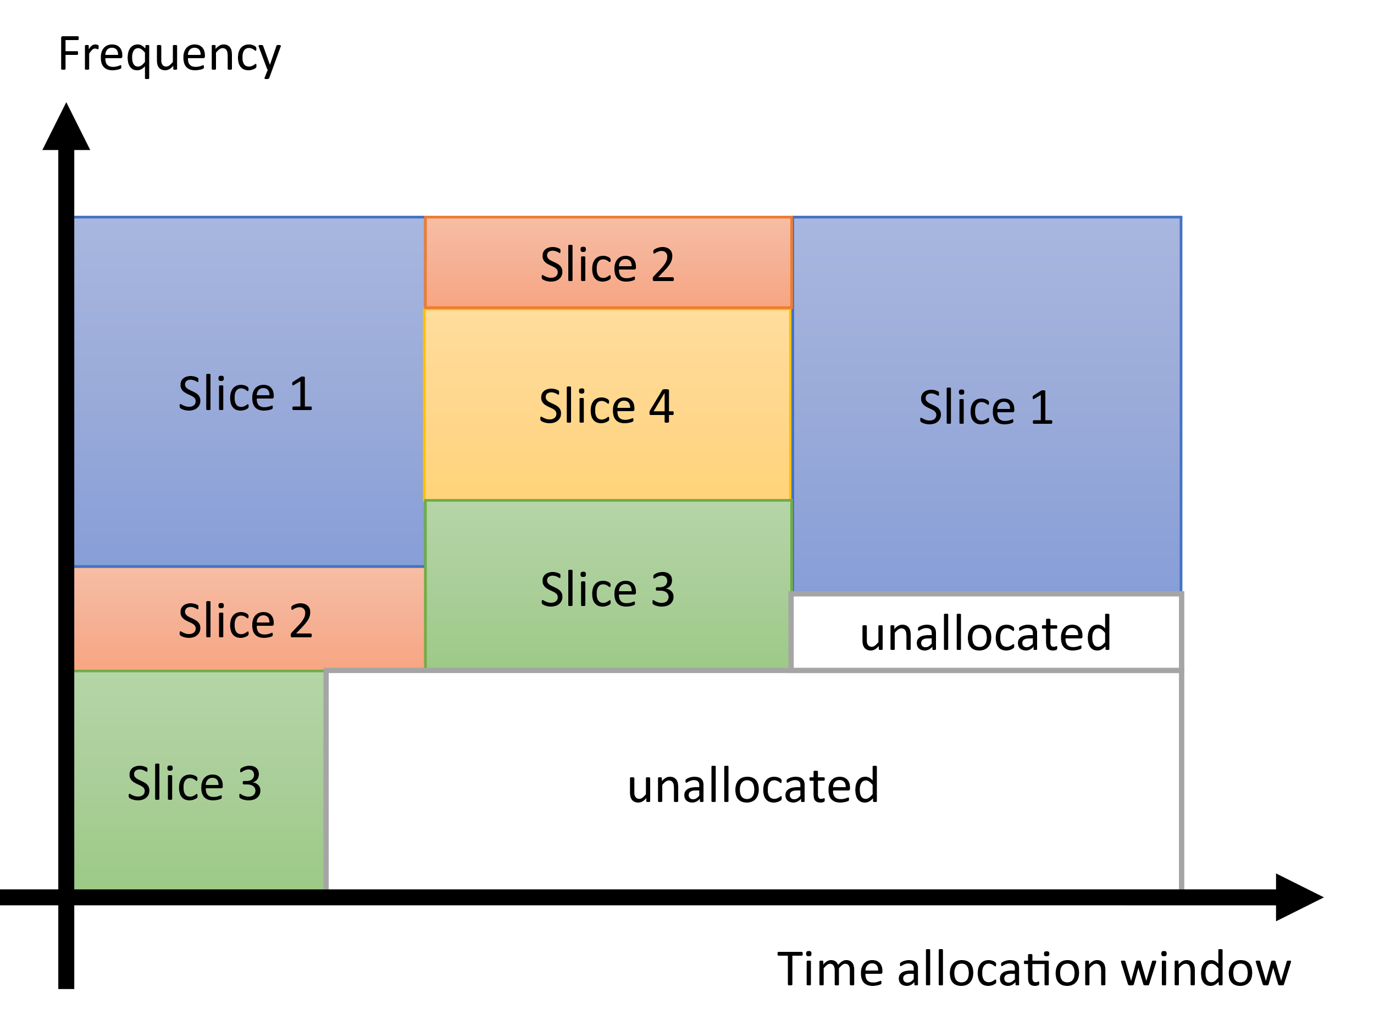
Related work
Our work deals with best BWP size from performance perspective
The [19] and [20] deal with radio resource partitioning in time-frequency plane to find largest unallocated space and achieve resource usage efficiency.
Our work deals with best bandwidth part (BWP) size from slice performance perspective
[19] C. Y. Chang, N. Nikaein, and T. Spyropoulos, “Radio access network resource slicing for flexible service execution,” INFOCOM 2018 - IEEE Conf. Comput. Commun. Work., pp. 668–673, 2018, doi: 10.1109/INFCOMW.2018.8407021.
[20] I. Oussakel, P. Owezarski, P. Berthou, and L. Houssin, “Toward Radio Access Network Slicing Enforcement in Multi-cell 5G System,” J. Netw. Syst. Manag., vol. 31, no. 1, p. 8, Jan. 2023, doi: 10.1007/s10922-022-09694-0.

Slide 8
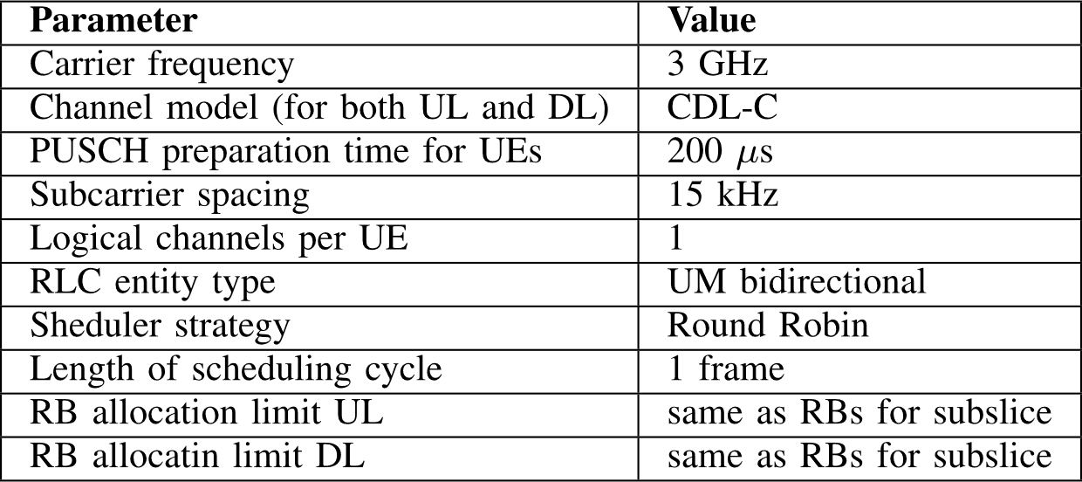
Simulations
5G-NR simulated using MATLAB 5G Toolbox system-level simulation tool called NR Cell Performance Evaluation with Physical Layer Integration, version R2021b
Subslice settings:
  Bandwidth in RBs
  Number of UEs and their requested rate, packet size, distance from base station
All UEs want to transmit/receive their requested rate in set size of packets at the start of simulation.
UL – uplink
DL – downlink
CDL-C – clustered delay line C
PUSCH – physical uplink shared channel
RLC – radio link control
UM – unacknowledged mode

Slide 9
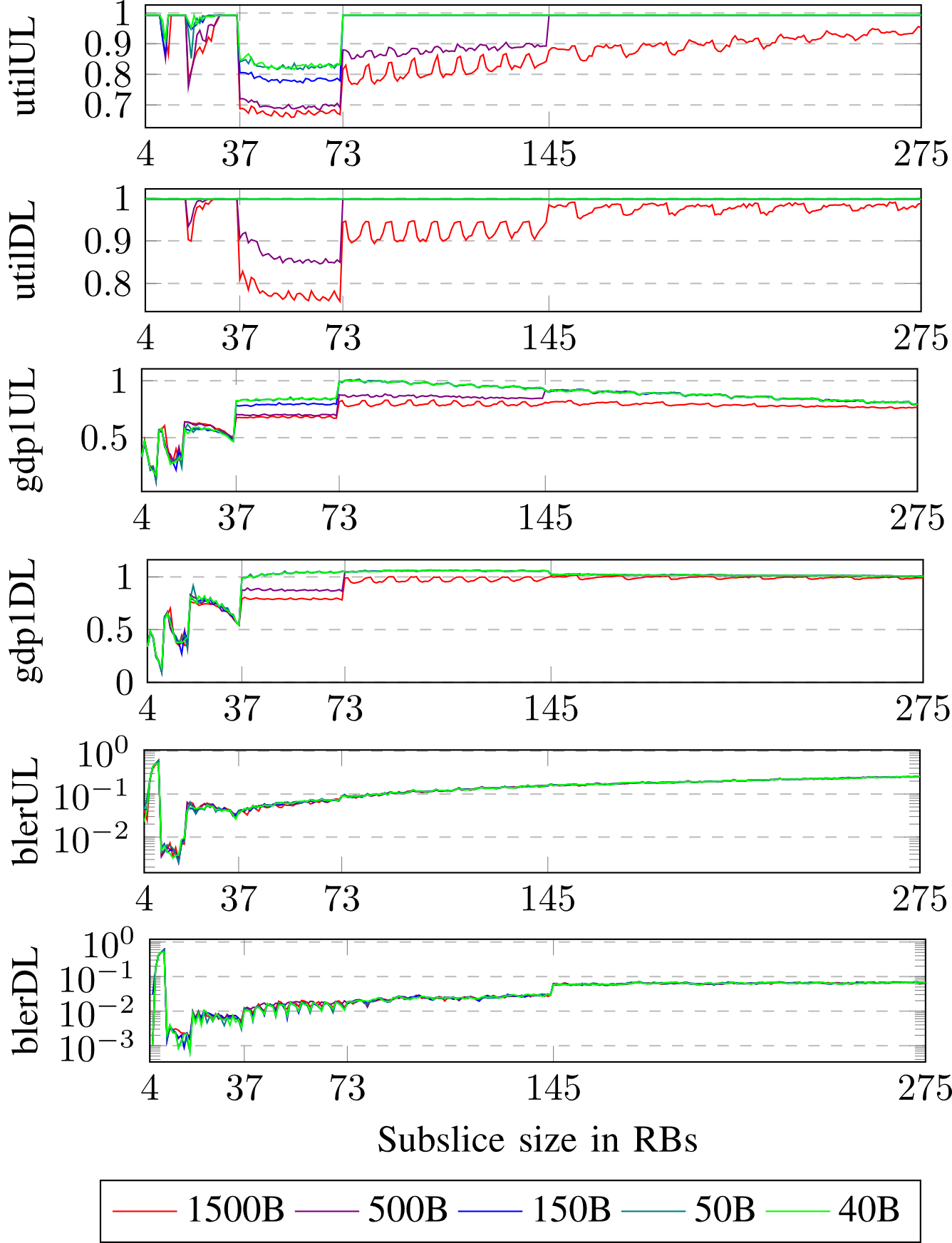
Dataset
Complete performance data of BWPs any size in range of 4-275 RBs
  For each RB allocated we have an UE which is able to consume it
Performance data consists of 6 key performance indicators (KPI)
We see performance dependence on BWP size
util – utilization, gdp1 – goodput per 1 RB, bler – block error ratio
UL – uplink, DL - downlink

Slide 10
Performance dependence on BWP size
The lowest utilization is when subslice size is in range of 37-73 RBs
Small subslices have
high utilization,
low goodput
Large subslices have high utilization,
high goodput
and high BLER
The highest goodput is when
subslice size is in range of 73-145 RBs
The lowest BLER is when
subslice size is in range of 10-18 RBs

Slide 11
Deciding slice reconfiguration operation
Slice reconfiguration decisions
  „merge“
  „no change“
  „split“
We want to decide slice reconfiguration based on performance not by size
  What if the performance dependence from size is different?
Propose performance data clustering into 3 clusters

Slide 12
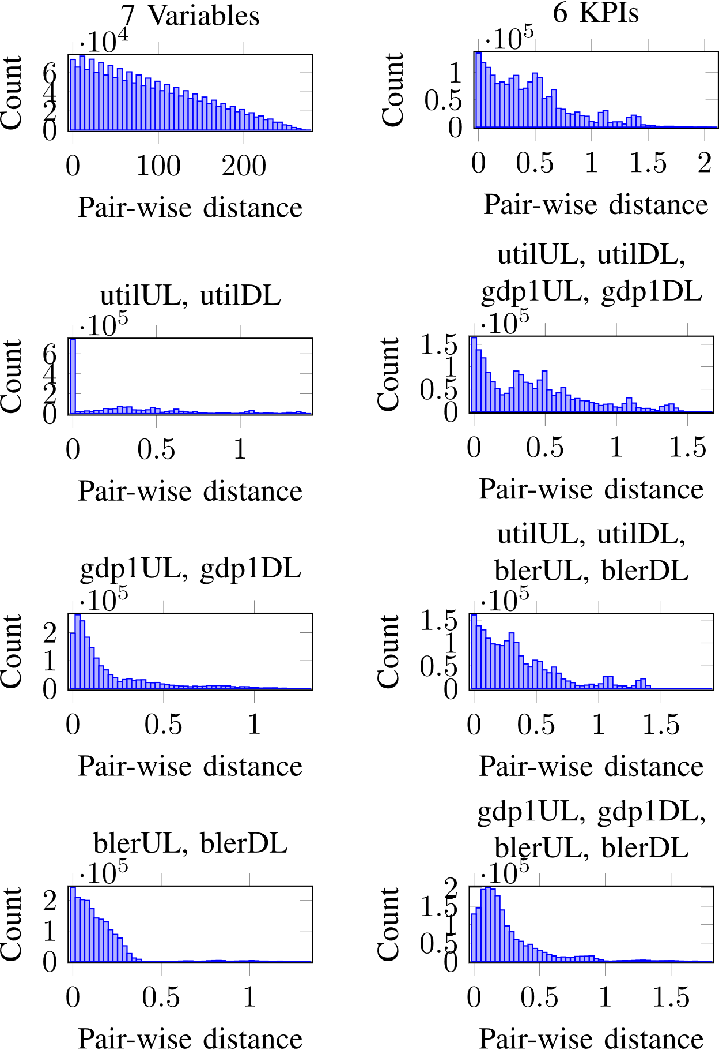
Evaluate data clusterability - histograms
Does not contain clusters
Looks promising
Calculate pair-wise Euclidean distances of data points
The histogram of all distances should be multimodal to expect the dataset to contain clusters.
Try clustering by 6 KPIs and by combinations of 4 KPIs

Slide 13
Selected clustering algorithms
Density-based,
  DBSCAN [13]
    Recommended settings [14]:
    Minimum number of points minPts (used 12)
    Radius ε, (used 0.2157)
Distribution-based,
  Gaussian Mixture Model (GMM) algorithm [11]
Centroid-based
  K-means [10]
Hierarchical-based.
  Agglomerative hierarchy clustering algorithm [12]
[10] J. MacQueen, “Some Methods for Classification and Analysis of MultiVariate Observations,” in Proc of Berkeley Symposium on Mathematical Statistics & Probability, 1965, pp. 281–297.
[11] D. Reynolds, “Gaussian Mixture Models,” in Encyclopedia of Biometrics, Boston, MA: Springer US, 2015, pp. 827–832. doi: 10.1007/978-1-4899-7488-4_196.
[12] L. Kaufman and P. J. Rousseeuw, Finding Groups in Data: An Introduction to Cluster Analysis, Wiley Seri. Wiley, 2009.
[13] M. Ester, H.-P. Kriegel, J. Sander, and X. Xu, “A density-based algorithm for discovering clusters in large spatial databases with noise,” Proc. 2nd Int. Conf. Knowl. Discov. Data Min., 1996
[14] E. Schubert, J. Sander, M. Ester, H. P. Kriegel, and X. Xu, “DBSCAN Revisited, Revisited,” ACM Trans. Database Syst., vol. 42, no. 3, pp. 1–21, Sep. 2017, doi: 10.1145/3068335.

Slide 14
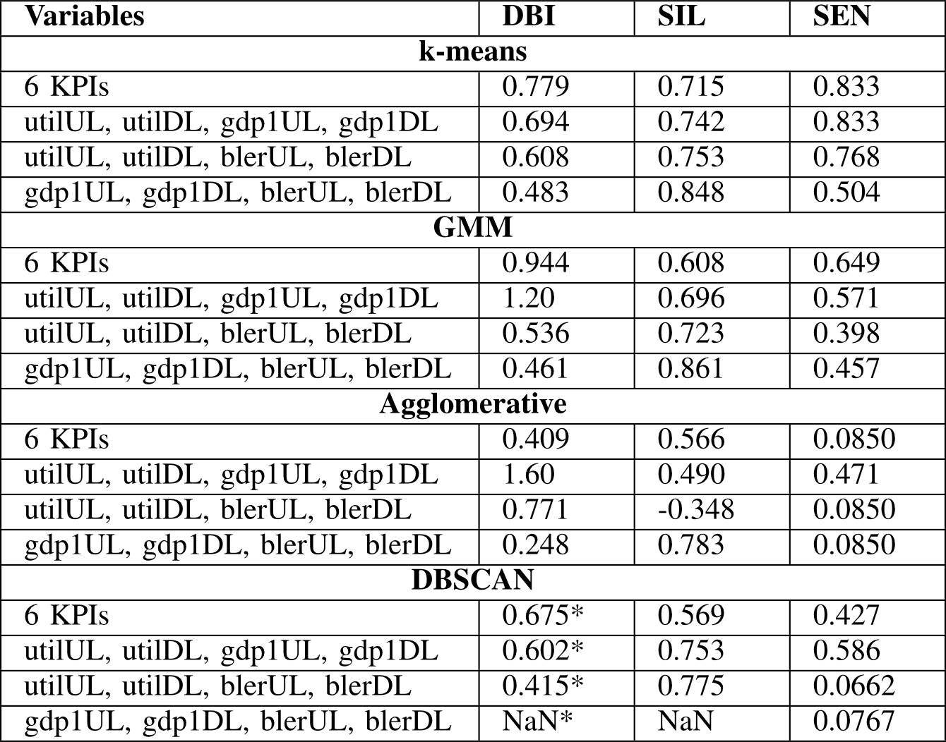
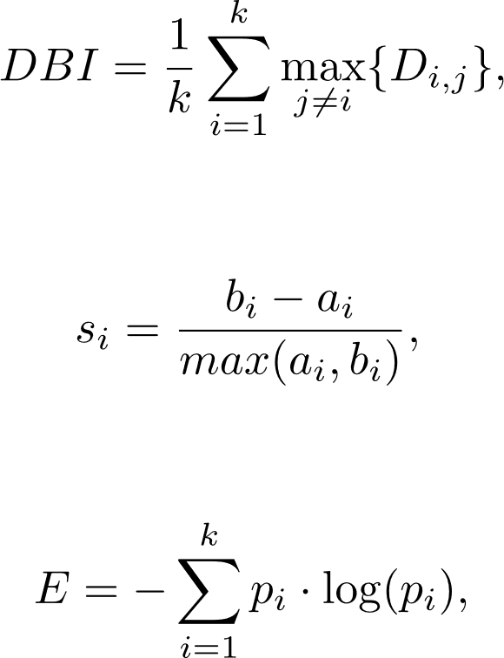
Evaluate data clusterability - statistics
Davies-Bouldin index (DBI) [15]
  The smaller values indicate better clustering.
The Silhouette coefficient (SIL) [16]
  High positive value means highly separable clusters.
sum of entropies (SEN) [17]
  Large values of entropy indicate poor clustering behaviour
2nd best
Best 1
[15] D. L. Davies and D. W. Bouldin, “A Cluster Separation Measure,” IEEE Trans. Pattern Anal. Mach. Intell., vol. PAMI-1, no. 2, pp. 224–227, Apr. 1979, doi: 10.1109/TPAMI.1979.4766909.
[16] P. J. Rousseeuw, “Silhouettes: A graphical aid to the interpretation and validation of cluster analysis,” J. Comput. Appl. Math., vol. 20, pp. 53–65, Nov. 1987, doi: 10.1016/0377-0427(87)90125-7.
[17] C. E. Shannon, “A Mathematical Theory of Communication,” Bell Syst. Tech. J., vol. 27, no. 4, pp. 623–656, 1948, doi: 10.1002/j.1538-7305.1948.tb00917.x.

Slide 15
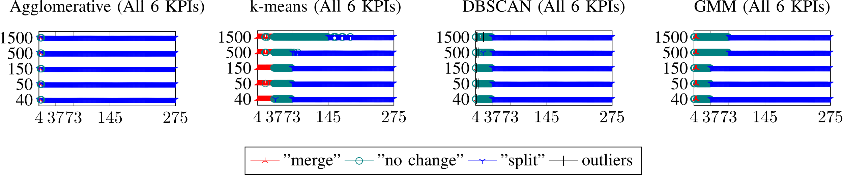
Visualization of clusters
Almost all of subslices too large
All clusters meaningful
Too small cluster of too small subslices
No subslice can be outlier
X-axis – subslice size in RBs
Y-axis – packet size in Bytes

Slide 16
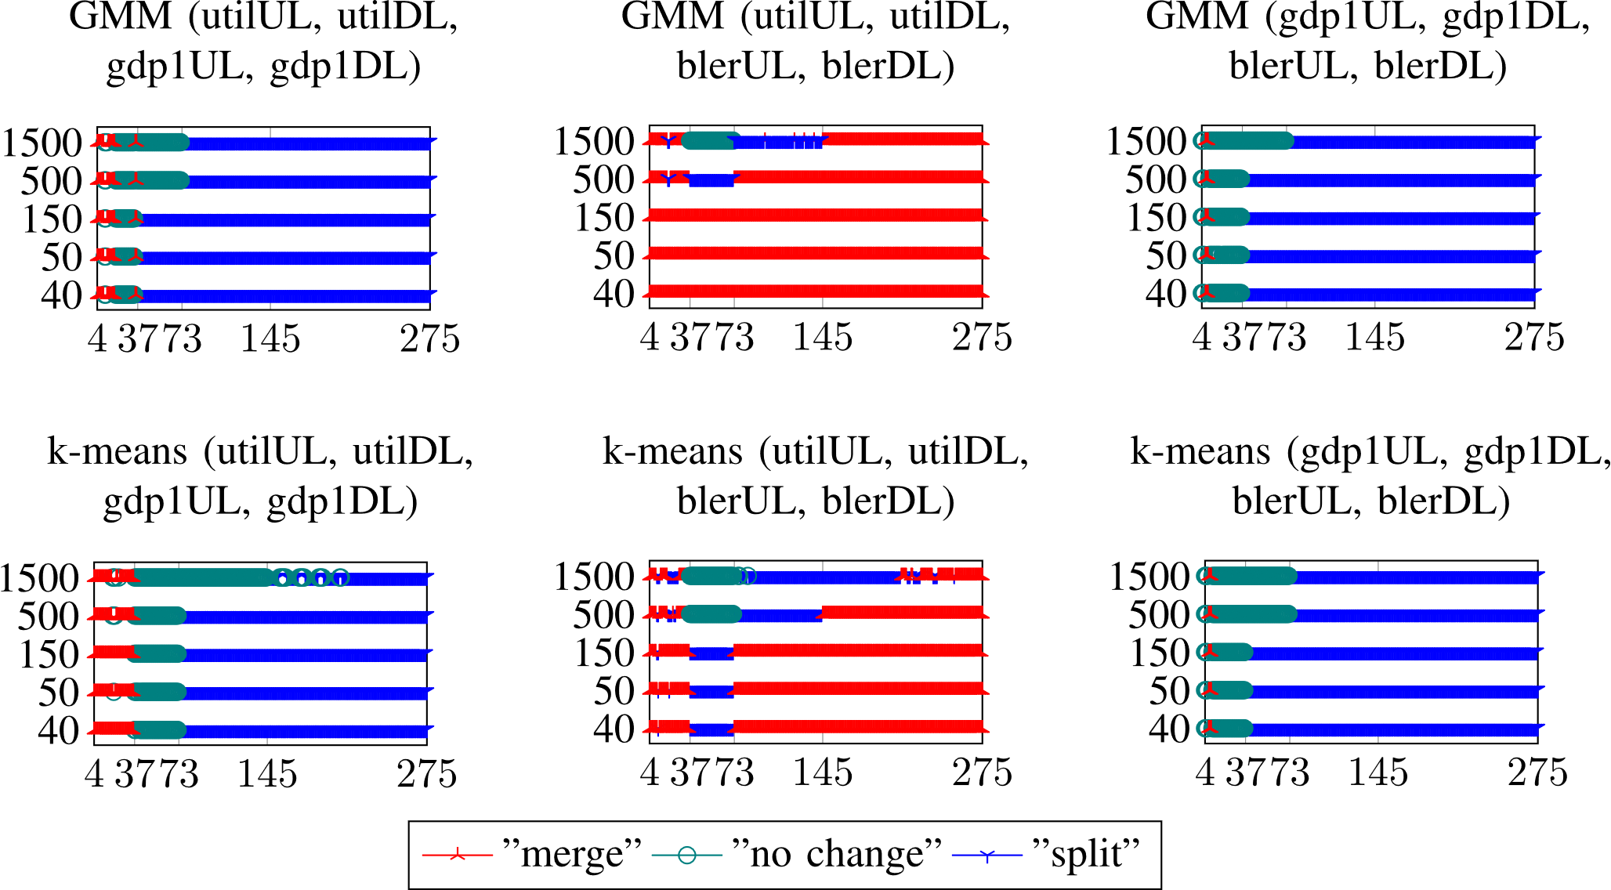
GMM and k-means results of 4 KPIs
If no BLER then similar clusters if all 6 KPIs considered
If goodput removed then similar performance of small and large subslices
If utilization removed then very few too small subslices
X-axis – subslice size in RBs
Y-axis – packet size in Bytes

Slide 17
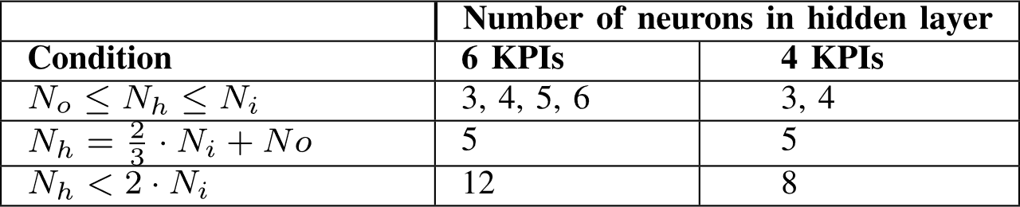
Neural network settings
Fully connected feedforward classifier neural network (NN)
  Input layer – 6 nodes (6 KPIs) or 4 nodes (utilUL, utilDL, gdp1UL, gdp1DL)
  Hidden layer(s) - ? Nodes
    Recommendations from [18]
  Output layer – 3 nodes – decisions: „merge“, „no change“, „split“
Try 1-2 layers and 2-22 nodes in layer
[18] J. Heaton, Introduction to Neural Networks with Java. Heaton Research, 2008.

Slide 18
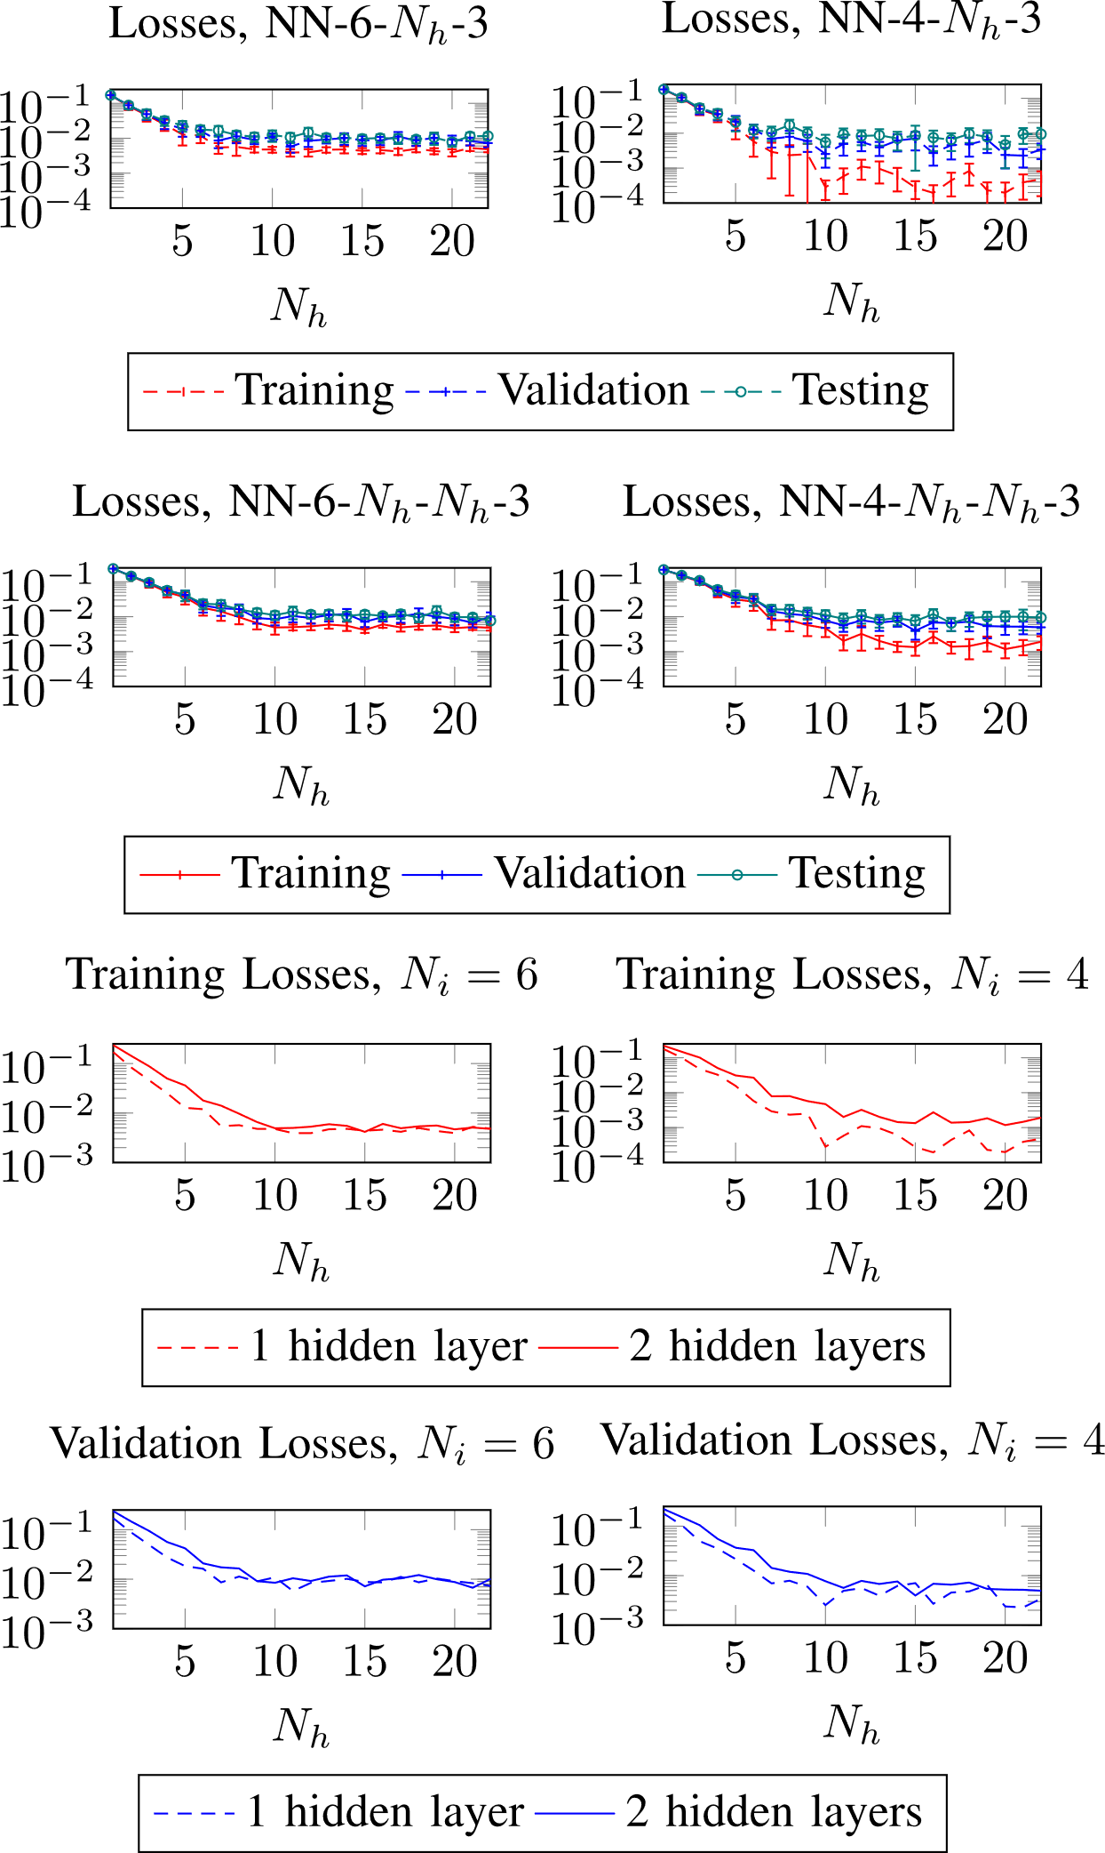
Trials to select hyperparameters for NN
1 layer 7, nodes
1 layer, 10 nodes
Find the minimum number of layers and nodes where cross entropy losses do not decrease further
Experiment with
  For 6 KPIs
    NN-6-7-3
  For 4 KPIs
    NN-4-10-3

Slide 19
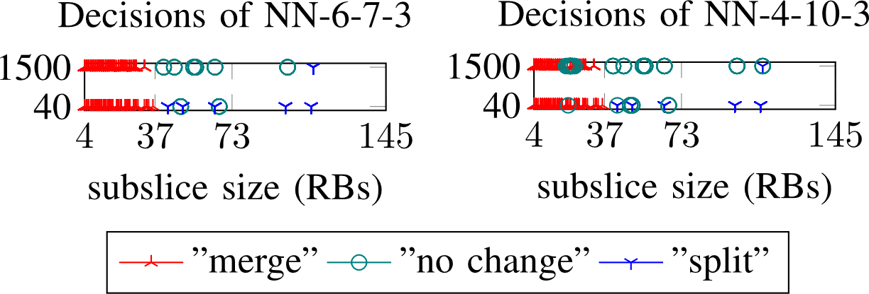
Classification experiments
Have performance values for subslices with size in range of 4-111 RBs
Results are acceptable
6 KPIs as inputs the NN classified too small subslices better

Slide 20
Conclusion
Given subslice performance depends on subslice size, we have presented the method to decide the subslice reconfiguration based on KPIs
The performance data was clustered into 3 clusters and the result was learned by classifier neural network
Experiments show that 6 KPIs are better than 4 KPIs as input data
This mechanism can help automatically decide subslices configuration

Slide 21
Future work
Investigate the subslice performance dependence on the subslice size if the UEs are not in a good signal coverage.

Slide 22
Thank you
This work has received funding partly from the European Union’s Horizon 2020 Research and Innovation Program under Grant 951867 ‘5G-ROUTES’ and Grant 101058505 ‘5G-TIMBER’. This work in the project “ICT programme” was supported by the European Union through European Social Fund, and TAR16013 Center of Excellence ‘EXCITE IT’.

