Slide 1
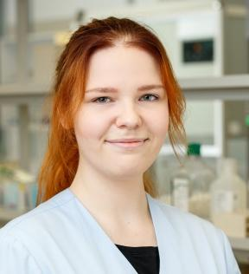
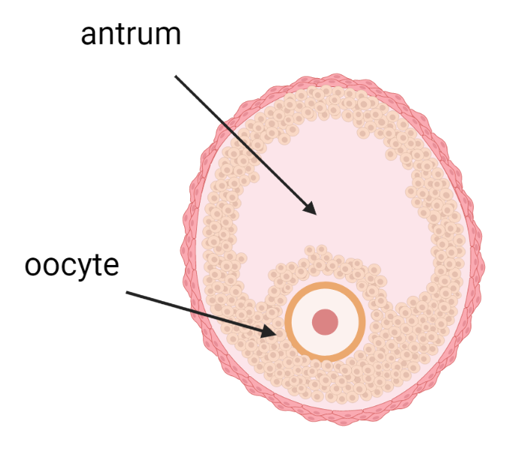
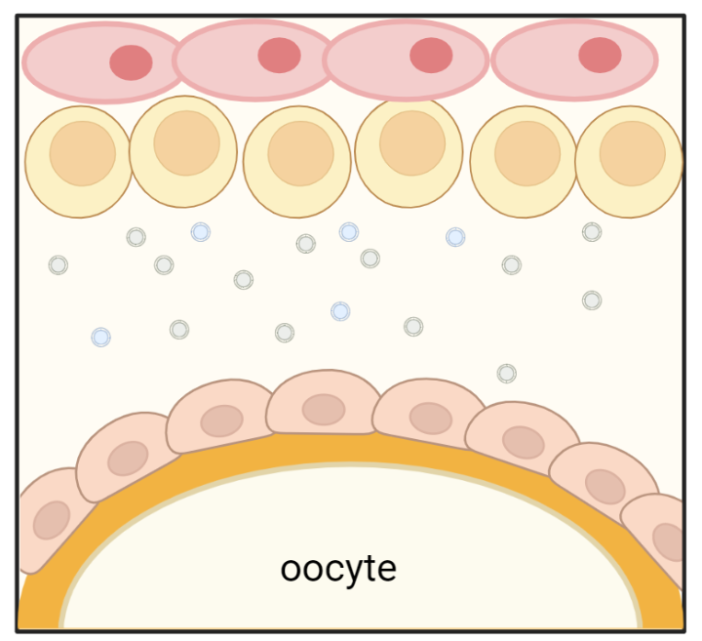
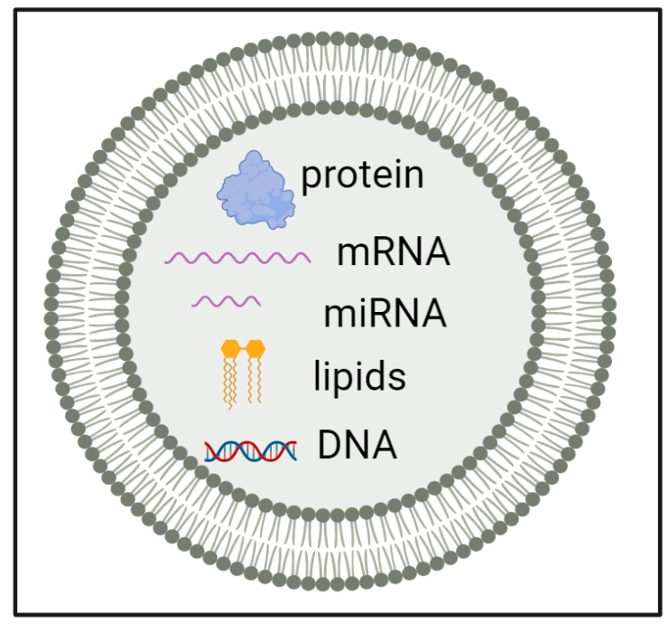
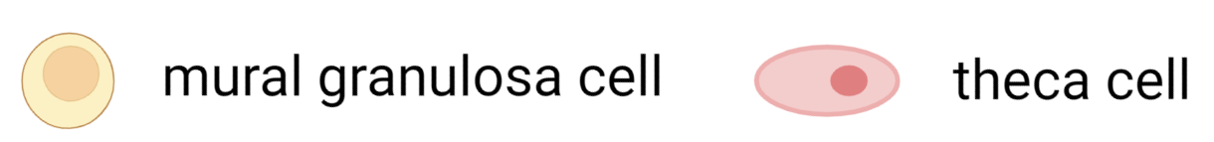

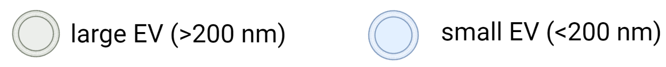

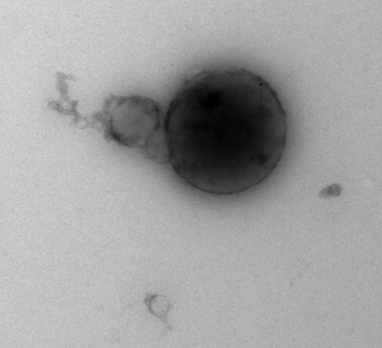
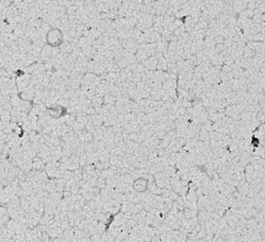
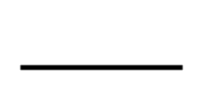

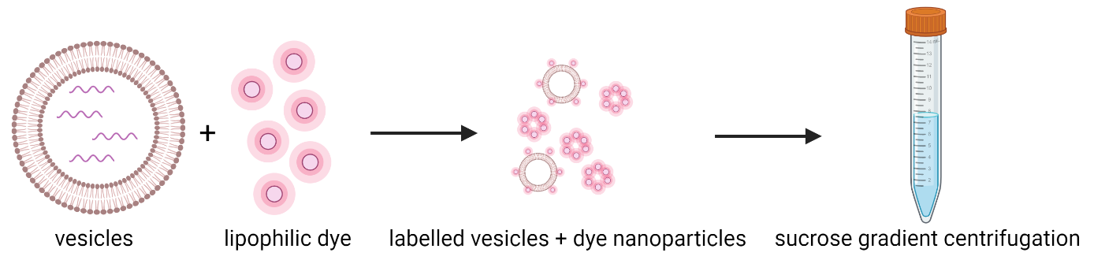
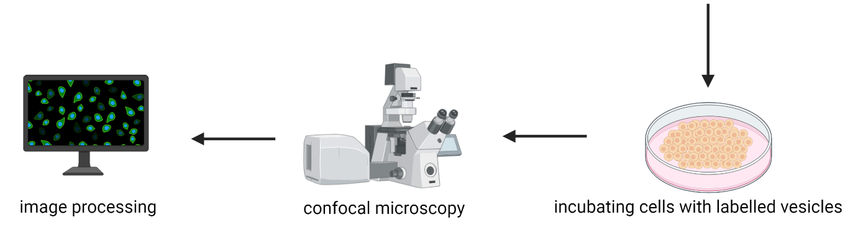




EXTRACELLULAR VESICLE SUBPOPULATIONS
IN HUMAN FOLLICULAR FLUID
Inge Varik¹, Paolo Guazzi², Olli-Pekka Smolander¹, Ileana Quintero³, Maija Puhka³, Katariina Johanna Saretok¹, Agne Velthut-Meikas¹
¹Tallinn University of Technology, Tallinn, Estonia; ²HansaBioMed Life Sciences Ltd, Tallinn, Estonia, ³University of Helsinki, Helsinki, Finland
INTRODUCTION
Ovarian follicle is the basic functional unit of the ovary containing an oocyte surrounded by supporting granulosa and theca cells. During follicle development, formation of fluid-filled antrum separates granulosa cells into two subpopulations. Cells surrounding the oocyte are cumulus granulosa cells (CGC) and cells surrounding the antrum are mural granulosa cells (MGC). Communication between the oocyte and granulosa cells is maintained by several mechanisms including transport of extracellular vesicle (EV) cargo. Follicular fluid EVs are lipid bilayer vesicles loaded with proteins, mRNAs, microRNAs, lipids, and DNA which are taken up by distinct cell types within the ovarian follicle allowing communication between distant cells.
VISUAL ABSTRACT
Table 1. Particle concentration measurements after EV subpopulation isolation by TFF demonstrate that the amount of small (<200 nm) particles in follicular fluid is roughly 5- to 20-fold higher than large particles.
Figure 2. NTA measurements show that the mean diameters of small and large particles are ~100 nm and ~250 nm, respectively.
MAIN RESEARCH QUESTIONS
Which miRNAs are specifically enriched in small or large follicular fluid EVs?
Do extracellular vesicles in human follicular fluid exert any effect on MGC/CGC proliferation, viability or steroidogenesis?
Are follicular fluid EV subpopulations functionally distinct?
Figure 3. TEM imaging shows that small and large EV preparations contain EV-like particles with non-collapsed morphology (arrows pointing to EV-like structures).
A. TEM image of large EV sample isolated from human FF.
B. TEM image of small EV sample isolated from human FF.
METHODS
The aim of the current project is to isolate EV subpopulations from human follicular fluid (FF) and to characterize their content and function.
EVs were isolated from 1.5 ml of FF collected from healthy women. FF was added to the size exclusion chromatography (SEC) column and after the sample had passed down, DPBS was added to the column. In total, 20 fractions, each 500 μl, were collected separately. Concentration of nanoparticles in each fraction was measured on Zetaview nanoparticle tracking analyzer (NTA). Protein concentration of each fraction was determined with Pierce BCA Protein Assay Kit. Based on these analyses, fractions 7-10 (2 ml) demonstrated highest number of particles and least amount of protein contamination (Figure 1).
Fractions 7-10 were pooled, diluted with DPBS and added to tangential flow filtration (TFF) column with pore size 200 nm. Filtrate containing particles with <200 nm diameter were collected. Column was washed with DPBS and washing solution was added to previously collected filtrate. DPBS was added to the TFF column to collect retentate which contains particles with >200 nm diameter. Samples were once again subjected to NTA analysis and then concentrated with 10 kDa centrifugal filter to 300-500 μl. Samples were stored at -20 °C until further analysis. Isolated EV samples were additionally characterized by ELISA and TEM.
A
B
500 nm
500 nm
Figure 4. ELISA analysis demonstrates presence of EV markers CD9, CD63 and CD81 and low levels of contaminating aplolipoproteins in fractions 7-10.
MICROSCOPY EXPERIMENT PLANS
In order to claim that EVs exert a particular physiological effect, one has to provide evidence that EVs are internalized by recipient cells. The most common method for detecting EV uptake involves the use of fluorescent lipid membrane dyes to stain EV membranes. Examples of such lipophilic dyes include PKH67, PKH26 and rhodamine B. Subsequent entry of EVs into recipient cells can be visualized by confocal microscopy.
RESULTS
Figure 1. Measurements of particle and protein concentration demonstrate that SEC is a suitable method for isolation of pure total EVs from human follicular fluid.
FUNDING: This research is funded by grant no PSG608 from the Estonian Research Council.

