Slide 1
Uncertainty in condition prediction of bridges based on assessment method – case study in Estonia
Sander Sein, Jose C. Matos, Juhan Idnurm

Slide 2
Sander Sein, Uncertainty in condition Prediction – Case study in Estonia
OUTLINE
Description of the problem
Bridges
Visual inspections
Non-destructive testing
Condition prediction
Conclusions

Slide 3
Sander Sein, Uncertainty in condition Prediction – Case study in Estonia
PROBLEM
Performance of bridges have direct impact on performance of overall road network
Most of the data connected to decision-making is collected with visual inspections
Visual inspections are cost-effective, but based on qualitative method (subjective opinion)
Non-destructive tests are repeatable and have quantitative results, which are difficult to integrate
Does the uncertainty of assessment affect condition preditction?

Slide 4
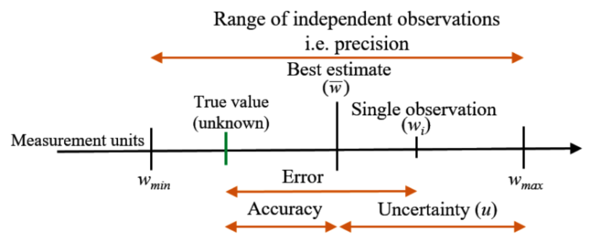
Sander Sein, Uncertainty in condition Prediction – Case study in Estonia
UNCERTAINTY
Ehrlich, C. (2014). Terminological aspects of the Guide to the Expression of Uncertainty in Measurement (GUM). Metrologia, 51(4), S145–S154.

Slide 5
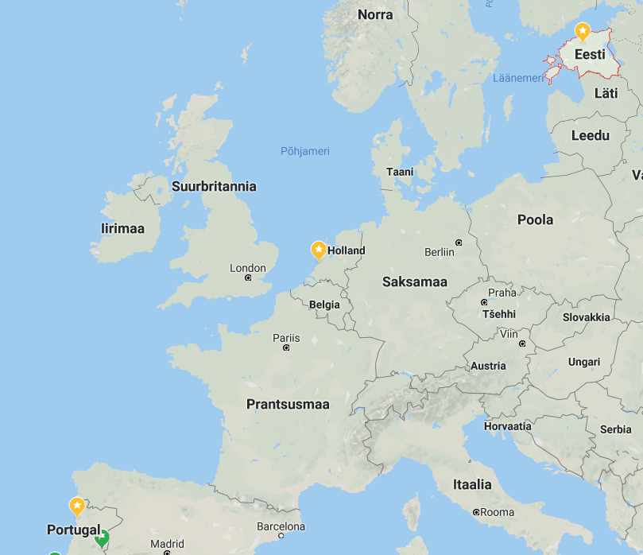
Sander Sein, Uncertainty in condition Prediction – Case study in Estonia
ESTONIA
Independence declared in 1918
Independence restored in 1991
Area is 45,336 km²
Population is approx. 1,35 million.
Screeshot from maps.google.com

Slide 6
Sander Sein, Uncertainty in condition Prediction – Case study in Estonia
BRIDGE MANAGEMENT IN ESTONIA
  Total number of bridges is approximately 3300
    Estonian Road Administration 1013
    Estonian Railways LTD. 523
    Local authorities approximately 700
    Forest roads ?
    Private roads ?
    Estonian Defense Forces *information not shared

Slide 7
Sander Sein, Uncertainty in condition Prediction – Case study in Estonia
BRIDGE MANAGEMENT IN ESTONIA
National roads

Slide 8
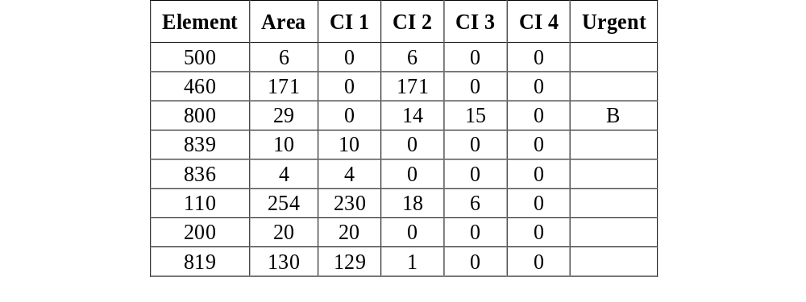
Sander Sein, Uncertainty in condition Prediction – Case study in Estonia
BRIDGE MANAGEMENT IN ESTONIA
Assessment
Evaluation of element condition (CI)
  Every element is evaluated, unit based
  4 states (1 very good – 4 very poor) without time frame
  Urgent damages with time frame

Slide 9
Sander Sein, Uncertainty in condition Prediction – Case study in Estonia
BRIDGE MANAGEMENT IN ESTONIA
Assessment
BCI (Bridge Condition Index) 0-100%
  Current element value/Total element value=CI
  Different elements have different weight factors
  Overall BCI is calculated based on weighted average

Slide 10
Sander Sein, Uncertainty in condition Prediction – Case study in Estonia
TYPICAL BRIDGE OF ESTONIA
Length: 14 m
One span
Built in 1975
Not repaired
Material: reinforced precast concrete
Main girder typology: simply supported beam

Slide 11
Sander Sein, Uncertainty in condition Prediction – Case study in Estonia
BRIDGES UNDER INVESTIGATION
VISUAL INSPECTION
ASSAKU
LAGEDI
SAKU
NON-DESTRUCTIVE TESTING
ALLIKU
KARUTIIGI

Slide 12
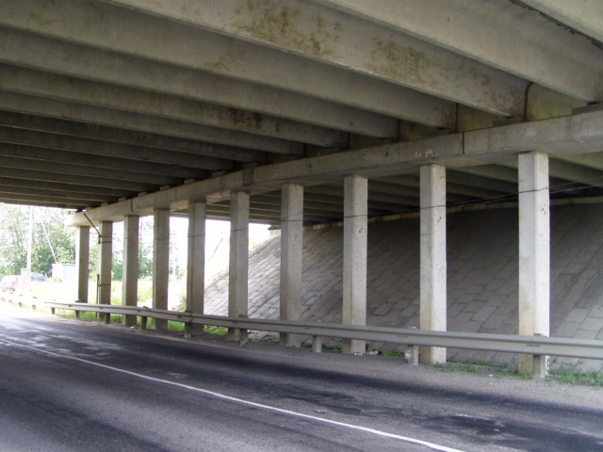
Sander Sein, Uncertainty in condition Prediction – Case study in Estonia
ASSAKU
BUILT IN 1970
PRECAST RC
INSPECTED BY EXPERTS
bms.teed.ee

Slide 13
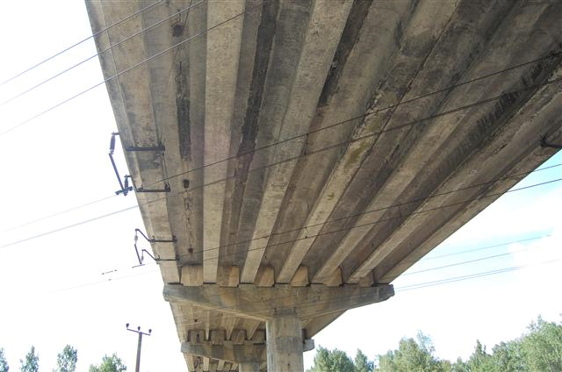
Sander Sein, Uncertainty in condition Prediction – Case study in Estonia
LAGEDI
BUILT IN 1989
PRECAST RC (PRE-STRESSED)
INSPECTED BY EXPERTS
bms.teed.ee

Slide 14
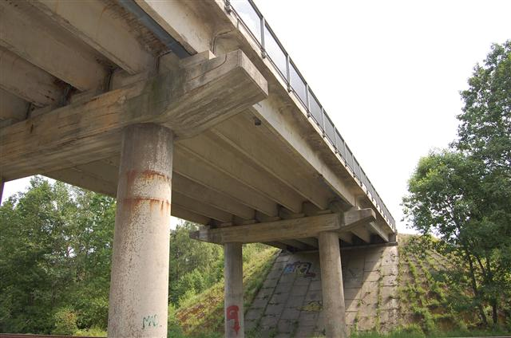
Sander Sein, Uncertainty in condition Prediction – Case study in Estonia
SAKU
BUILT IN 1974
RECONSRUCTED IN 2005
PRECAST RC
INSPECTED BY STUDENTS
bms.teed.ee

Slide 15
Sander Sein, Uncertainty in condition Prediction – Case study in Estonia
VISUAL INSPECTIONS
BCI
Inspector | Lagedi CI | Assaku CI | Saku CI
1 | 48.9 | 66.9 | 49.3
2 | 36.7 | 66.7 | 74.0
3 | 38.2 | 66.8 | 19.3
4 | 36.7 | 87.0 | 76.1
5 | 46.0 | 75.1 | 70.1
6 | 39.8 | 87.0 | -
7 | 55.3 | 88.3 | -
Mean | 43.1 | 76.8 | 57.8
SD | 6.6 | 9,6 | 21,5

Slide 16
Sander Sein, Uncertainty in condition Prediction – Case study in Estonia
NON-DESTRUCTIVE TESTS
EASY
QUICK
Compressive strength of concrete cover according to EVS-EN 12504-2
Carbonation depth according to EVS-EN 14630
Thickness of rebar cover

Slide 17
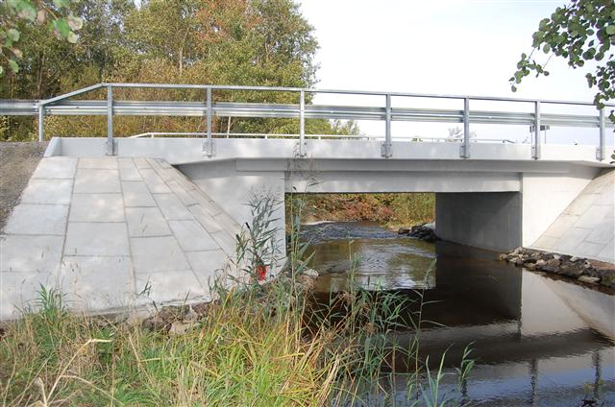
Sander Sein, Uncertainty in condition Prediction – Case study in Estonia
ALLIKU
BUILT IN 1975
RECONSRUCTED IN 2010
RC SLAB
TESTED BY EXPERTS AND STUDENTS
bms.teed.ee

Slide 18
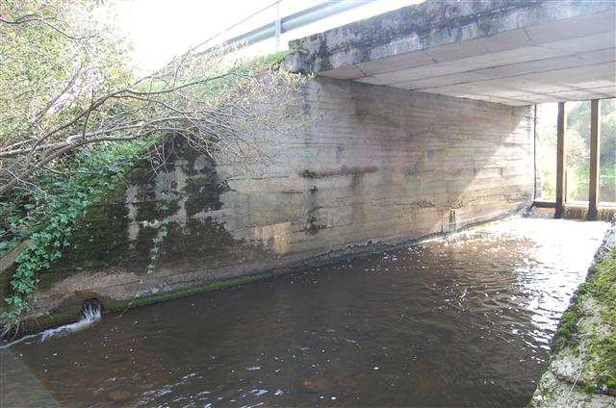
Sander Sein, Uncertainty in condition Prediction – Case study in Estonia
KARUTIIGI
BUILT IN 1980
RECONSRUCTED IN 2018*
RC SLAB*
TESTED BY EXPERTS
bms.teed.ee

Slide 19
Sander Sein, Uncertainty in condition Prediction – Case study in Estonia
NON-DESTRUCTIVE TESTS
Tester | Rebound value Q | Carbonation depth [mm] | Average cover depth [mm]
E 1 | 66.5 | 9 | 45
E 2 | 67.7 | 8 | 45
S 1 | 66.1 | 6 | 43
S 2 | 63.7 | 7 | 40
S 3 | 64.5 | 7 | 41
S 4 | 62.8 | 7 | 45
S 5 | 63.8 | 6 | 42
S 6 | 67.3 | 7 | 46
S 7 | 66.6 | 7 | 43
S 8 | 65.2 | 7 | 41
Mean | 65.4 | 7.1 | 43.1
SD | 1.6 | 0.83 | 2.0

Slide 20
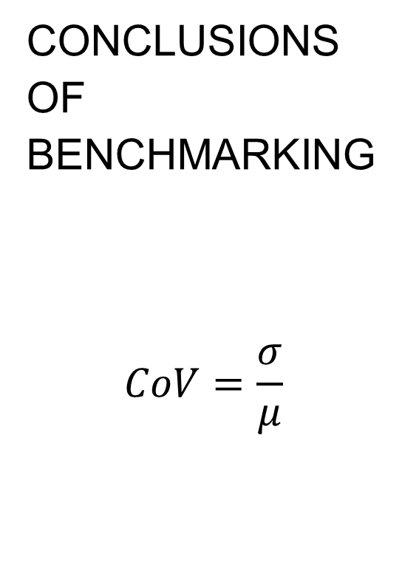
Sander Sein, Uncertainty in condition Prediction – Case study in Estonia
CONCLUSIONS OF BENCHMARKING
$$CoV=\frac{σ}{μ}$$
Method | CoV | CoV*4
Visual inspection – students | 0.37 | 1.49
Visual inspection – engineers | 0.15 | 0.61
Visual inspection - experts | 0.13 | 0.50
Rebound hammer | 0.02 | 0.10
Carbonation | 0.12 | 0.47
Cover depth | 0.05 | 0.19

Slide 21
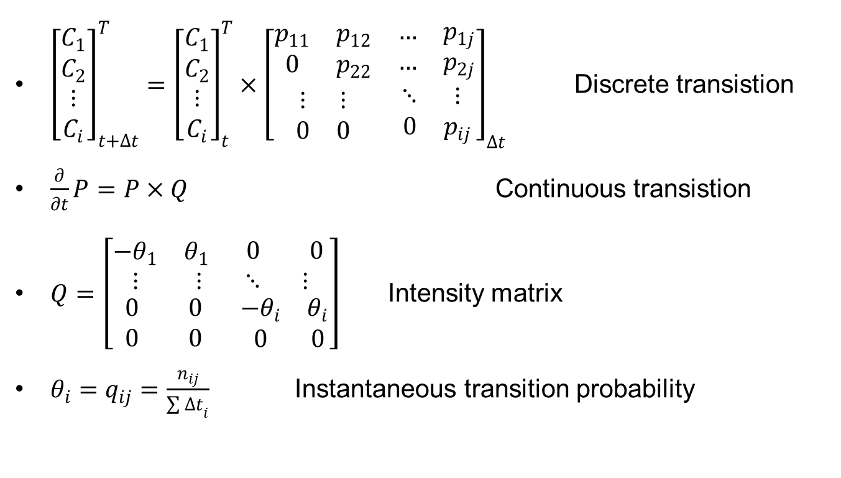
Sander Sein, Uncertainty in condition Prediction – Case study in Estonia
PREDICTIVE MODEL
Continuous-time Markov Process
State-dependent
Time-independent
${\left[\begin{matrix}\begin{matrix}C_{1} \\ C_{2}\end{matrix} \\ \begin{matrix}⋮ \\ C_{i}\end{matrix}\end{matrix}\right]}_{t+∆t}^{T}={\left[\begin{matrix}\begin{matrix}C_{1} \\ C_{2}\end{matrix} \\ \begin{matrix}⋮ \\ C_{i}\end{matrix}\end{matrix}\right]}_{t}^{T}×{\left[\begin{matrix}\begin{matrix}p_{11} & p_{12} \\ 0 & p_{22}\end{matrix} & \begin{matrix}… & p_{1j} \\ … & p_{2j}\end{matrix} \\ \begin{matrix}⋮ & ⋮ \\ 0 & 0\end{matrix} & \begin{matrix}⋱ & ⋮ \\ 0 & p_{ij}\end{matrix}\end{matrix}\right]}_{∆t}$ Discrete transistion
$\frac{∂}{∂t}P=P×Q$ Continuous transistion
$Q=\left[\begin{matrix}\begin{matrix}{−θ}_{1} & θ_{1} \\ ⋮ & ⋮\end{matrix} & \begin{matrix}0 & 0 \\ ⋱ & ⋮\end{matrix} \\ \begin{matrix}0 & 0 \\ 0 & 0\end{matrix} & \begin{matrix}−θ_{i} & θ_{i} \\ 0 & 0\end{matrix}\end{matrix}\right]$ Intensity matrix
$θ_{i}=q_{ij}=\frac{n_{ij}}{{\sum{∆t}}_{i}}$ Instantaneous transition probability

Slide 22
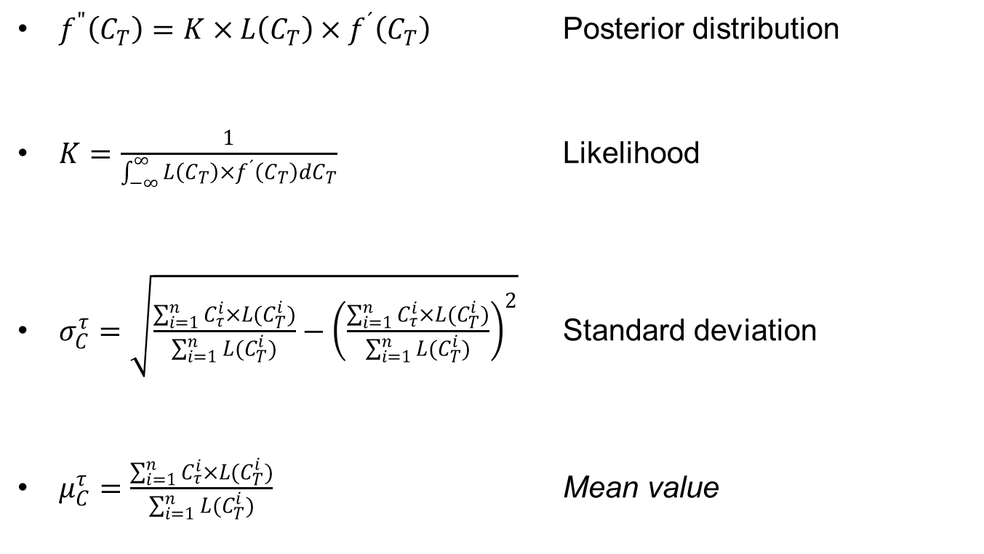
Sander Sein, Uncertainty in condition Prediction – Case study in Estonia
INFERENCE
Bayesian updating with simulation
[Neves, L.C. and Frangopol, D.M, 2005]
$f^{"}\left(C_{T}\right)=K×L\left(C_{T}\right)×f^{´}\left(C_{T}\right)$ Posterior distribution
$K=\frac{1}{\int_{−∞}^{∞}{L\left(C_{T}\right)×f^{´}\left(C_{T}\right)dC_{T}}}$ Likelihood
$σ_{C}^{τ}=\sqrt{\frac{\sum_{i=1}^{n}{C_{τ}^{i}}×L(C_{T}^{i})}{\sum_{i=1}^{n}{L(C_{T}^{i})}}−{\left(\frac{\sum_{i=1}^{n}{C_{τ}^{i}}×L(C_{T}^{i})}{\sum_{i=1}^{n}{L(C_{T}^{i})}}\right)}^{2}}$ Standard deviation
$μ_{C}^{τ}=\frac{\sum_{i=1}^{n}{C_{τ}^{i}}×L(C_{T}^{i})}{\sum_{i=1}^{n}{L(C_{T}^{i})}}$ Mean value

Slide 23
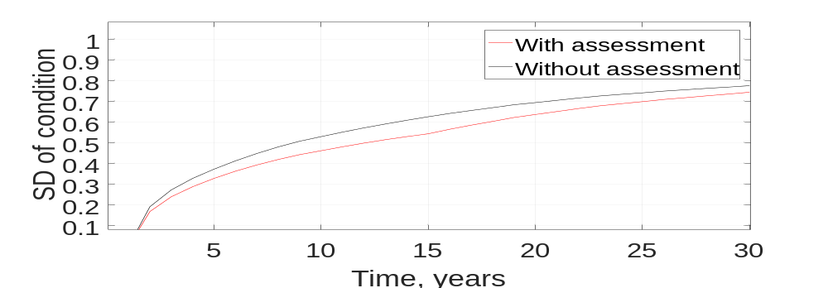
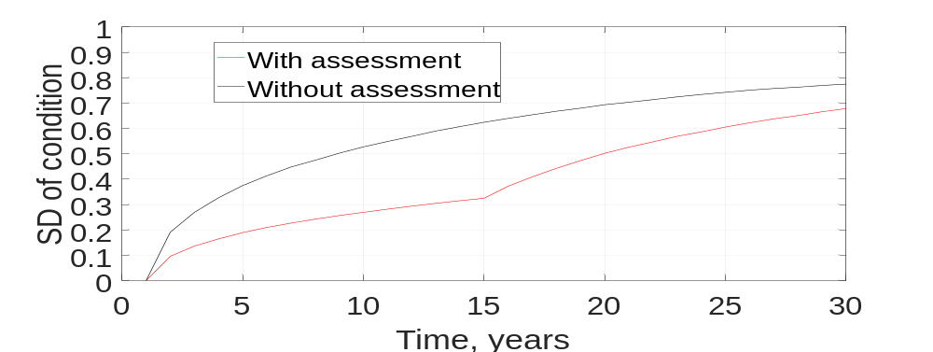
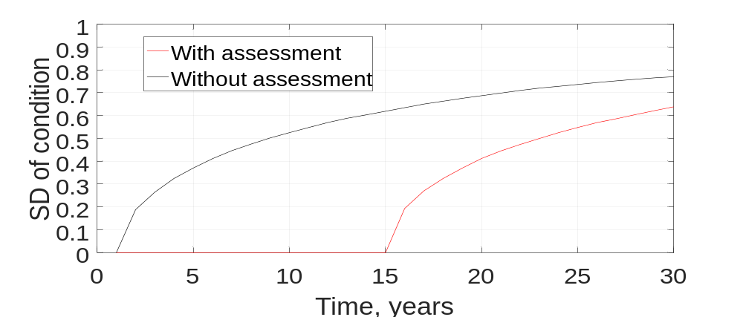
Sander Sein, Uncertainty in condition Prediction – Case study in Estonia
RESULTS
Students
Experts
NDT*

Slide 24
Sander Sein, Uncertainty in condition Prediction – Case study in Estonia
CONCLUSIONS
Based on the Standard deviation
It is better to inspect bridges
Experienced engineers give more accurate assessment than students
Bridge level assessments are more accurate than element level
Experts are almost as accurate as non-destructive tests
Using NDTs in addition is suggested, but the combination of visual assessment and NDT results should be carefully considered

Slide 25
Sander Sein, Uncertainty in condition Prediction – Case study in Estonia
ACKNOWLEDGEMENT
COST Action TU1406
Archimedes Foundation
Professor Karl Õiger Scholarship Foundation

Slide 26
Sander Sein, Uncertainty in condition Prediction – Case study in Estonia
THANK YOU FOR YOUR ATTENTION!
sein.sander@taltech.ee

