Slide 1
Radio Access Network Subslicing in Closed Control Loop for Improved Slice Performance Management
Marika Kulmar
Supervisors:
  Professor Muhammad Mahtab Alam,
  Dr. Ivo Müürsepp,
  Dr. Sven Pärand.

Slide 2

Outline
Introduction
Background and state of the art
Contributions (5)
  How many subslices
  Subslice performance vs size
  RAN subslicing algorithms
  Training data labeling
  Subslice processing
Conclusion and future works
How many slices can be in the RAN?

Slide 3
Introduction
CN
Network slicing enables to build multiple logical networks on top of physical infrastructure
Network services are implemented as network functions (NF)
Virtualization → VNF can work on general-purpose hardware with sufficient computing, storage and networking resources
Slicing benefits are resource allocation efficiency and better SLA satisfaction
NF
NF
...
NF
NF
NF
RAN
DN
(Internet)
UPF
(Gateway)
UE
Network
slicing
Slice i
CN NFs & resources
Slice
CN
CN
RAN NFs & resources
DN
(Internet)
UPF
(Gateway)
DN
(Internet)
RAN
CN – core network
RAN – radio access network
UE
RAN
...

Slide 4
Motivation
How many subslices can be in the RAN slice for best slice performance?
3GPP and GSMA standards specify different slice types but not the maximum number of slices in the network
Investigate how many slices can be present in 5G RAN
By subslicing a RAN slice which has a fixed bandwidth part (BWP), it is investigated whether the RAN slice performance improve
Key performance indicators (KPI)
  Bandwidth utilization
  Goodput per one resource block (RB)
  Block error ratio (BLER)
Subslicing for slice performance improvement is open research topic

Slide 5

Problem statement
Open issues
  RAN slice performance dependence on slice size
  How this knowledge can be used to create suitably sized subslices to improve RAN slice performance?
  How can automatic subslicing improve RAN slice performance?

Slide 6

Research questions
RQ1: how many subslices can be in the RAN slice?
RQ2: how much radio resource can be allocated to the slice and subslice to achieve the best performance?
RQ3: how users should be clustered, and slice bandwidth be allocated to subslices to improve RAN slice performance?
RQ4: what is the impact of RAN subslicing under the management closed control loop framework?

Slide 7
Integrated vs disintegrated RAN
Monolith gNB disaggregated and split
VNFs use computing, storage and networking resources
PNFs (antennas, RU) use radio resources
Resource allocation is the most relevant research topic
Cloud /
DC
CU-CP
CU-UP
CU
CU
CU
Opt. 2
Opt. 2
Opt. 2
PoP
DC / Cloud
Opt. 2
DU
DU
DU
DU
DU
Opt. 6
RU
Opt. 7-2
Opt. 8
RU
...
RU
Site
Site
Radio resources

Slide 8
Contribution 1 (how many subslices), related work
Standards specify 3-6 slice types but not the maximum number of slices
Most research works with 2-3 slices when doing radio resource allocation for RAN slices
Research gap
  The slice bandwidth taken minimum to show proposed contribution better than SOTA
Scheduler for RAN slicing [42] | URLLC, eMBB, MVNO | 10 MHz, 48 RBs
Radio resource slicing [43] | Fixed, dynamic, on-demand slices | 5 MHz, 25 RBs, LTE
Two-level slice scheduler [45] | URLLC, eMBB | 5MHz, 25 RBs, LTE
Two-level scheduler [46] | URLLC, eMBB, mMTC | 150 RBs
Soft-slicing scheme [47] | URLLC, eMBB, IIoT | Up to 200 RBs per gNB
[42] S. Mandelli, M. Andrews, S. Borst, and S. Klein, “Satisfying Network Slicing Constraints via 5G MAC Scheduling,” in IEEE INFOCOM 2019 - IEEE Conference on Computer Communications, IEEE, Apr. 2019, pp. 2332–2340. doi: 10.1109/INFOCOM.2019.8737604.
[43] R. Schmidt, C.-Y. Chang, and N. Nikaein, “Slice Scheduling with QoS-Guarantee Towards 5G,” in 2019 IEEE Global Communications Conference (GLOBECOM), IEEE, Dec. 2019, pp. 1–7. doi: 10.1109/GLOBECOM38437.2019.9013258.
[45] S. Bakri, P. A. Frangoudis, and A. Ksentini, “Dynamic Slicing of RAN Resources for Heterogeneous Coexisting 5G Services,” in 2019 IEEE Global Communications Conference (GLOBECOM), IEEE, Dec. 2019, pp. 1–6. doi: 10.1109/GLOBECOM38437.2019.9013954.
[46] Y. Han, X. Tao, X. Zhang, and S. Jia, “Hierarchical Resource Allocation in Multi-Service Wireless Networks with Wireless Network Virtualization,” IEEE Trans. Veh. Technol., pp. 1–1, 2020, doi: 10.1109/TVT.2020.3019217.
[47] W. Shi et al., “Two-Level Soft RAN Slicing for Customized Services in 5G-and-Beyond Wireless Communications,” IEEE Trans. Ind. Informatics, vol. 18, no. 6, pp. 4169–4179, Jun. 2022, doi: 10.1109/TII.2021.3083579.

Slide 9
Contribution 1, method
Simulate one 5G NR BWP as a RAN slice
  Measure slice performance if slice is subsliced into 2 to 10 subslices
Subslicing
  Slice UEs grouped
  Slice BWP divided
  Smaller BWPs allocated to the UE groups
Planned capacity use
  Close-to-slice overload due to resource utilization efficiency goal on slicing
Iteration 1:
1 subslice,
1 set of UEs
bandwidth
f, Hz
Iteration 2:
2 subslices,
2 sets of UEs
bandwidth
f, Hz
...
Iteration N:
N subslices,
N sets of UEs
bandwidth
f, Hz

Slide 10
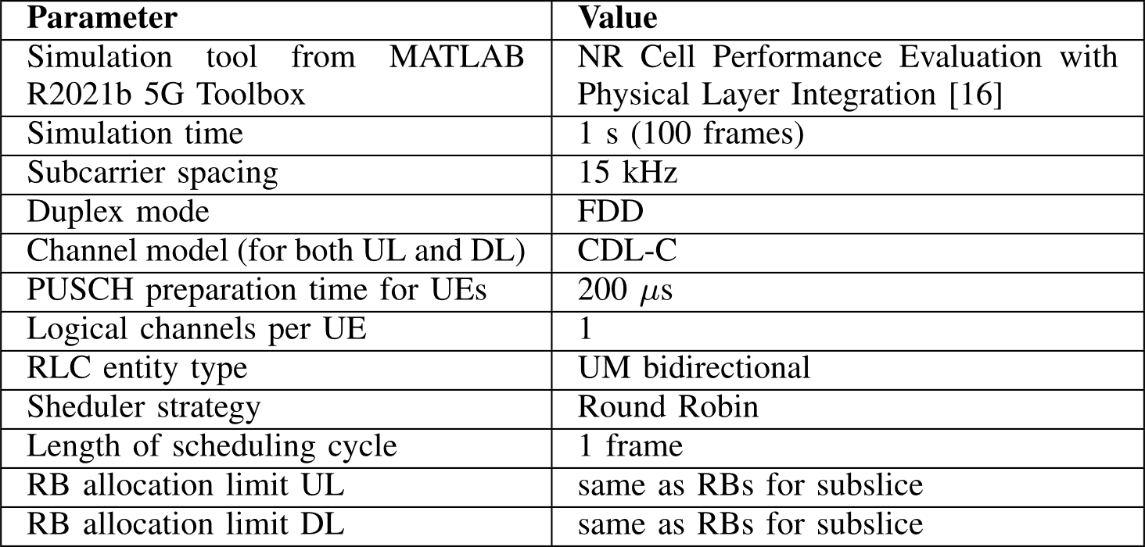
General settings for all simulations
[16] MathWorks, “NR Cell Performance Evaluation with Physical Layer Integration,” 2022. https://se.mathworks.com/help/5g/ug/nr-cell-performance-evaluation-with-physical-layer-integration.html (accessed Jan. 19, 2022).

Slide 11
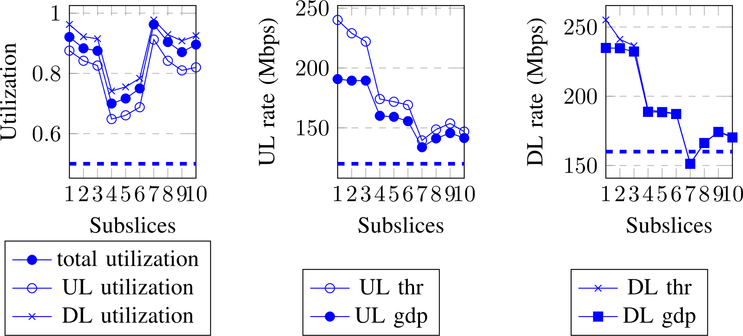
Contribution 1, results
Measured slice bandwidth utilization, throughput, goodput
  Slice utilization is the average utilization of all subslices
  Slice throughput is the sum of throughputs of subslices
  Slice goodput is the sum of goodput of subslices
When more subslices then one subslice is smaller, and slice performance degraded

Slide 12




Contribution 2 (subslice performance vs size), related work
Efficient resource allocation results the slice in close-to-slice overload situation.
If 5G-NR BWP is smaller than 20 RBs, then control blocks puncture each other and increase coupling loss [112].
For UE, the smaller bandwidth to use, the more energy efficient it is [113].
Research gap
  The BWP size is not investigated for performance
[112] K. Hooli et al., “Extending 5G to narrow spectrum allocations,” IEEE J. Sel. Areas Commun., pp. 1–1, 2023, doi: 10.1109/JSAC.2023.3273703.
[113] W. Yang et al., “Narrowband Wireless Access for Low-Power Massive Internet of Things: A Bandwidth Perspective,” IEEE Wirel. Commun., vol. 24, no. 3, pp. 138–145, Jun. 2017, doi: 10.1109/MWC.2017.1600298.

Slide 13
Contribution 2, method
Plan simulations
Subslice sizes 4-275 RBs
For each RB allocated one UE admitted
UE settings
  UE requested rate (theoretical maximum is 1.33 Mbps per RB)
  UE packet size [40 B, 50 B, 150 B, 500 B, 1500 B]
  UE BLER (determined by selection of UE distance from gNB)
    Good BLER (distance 1-275 m)
    Medium BLER (distance 1001-1275 m)
    Poor BLER (distance 6001-6275 m)
bandwidth
f, Hz
KPI | Description
utilUL | Bandwidth utilization in uplink
utilDL | Bandwidth utilization in downlink
gdp1UL | Goodput per one RB in uplink
gdp1DL | Goodput per one RB in downlink
blerUL | Block error ratio in uplink
blerDL | Block error ratio in downlink
RB – resource block (180 kHz, if subcarrier spacing is 15 kHz)
UL – uplink
DL – downlink
goodput – application level throughput
BLER – block error ratio

Slide 14
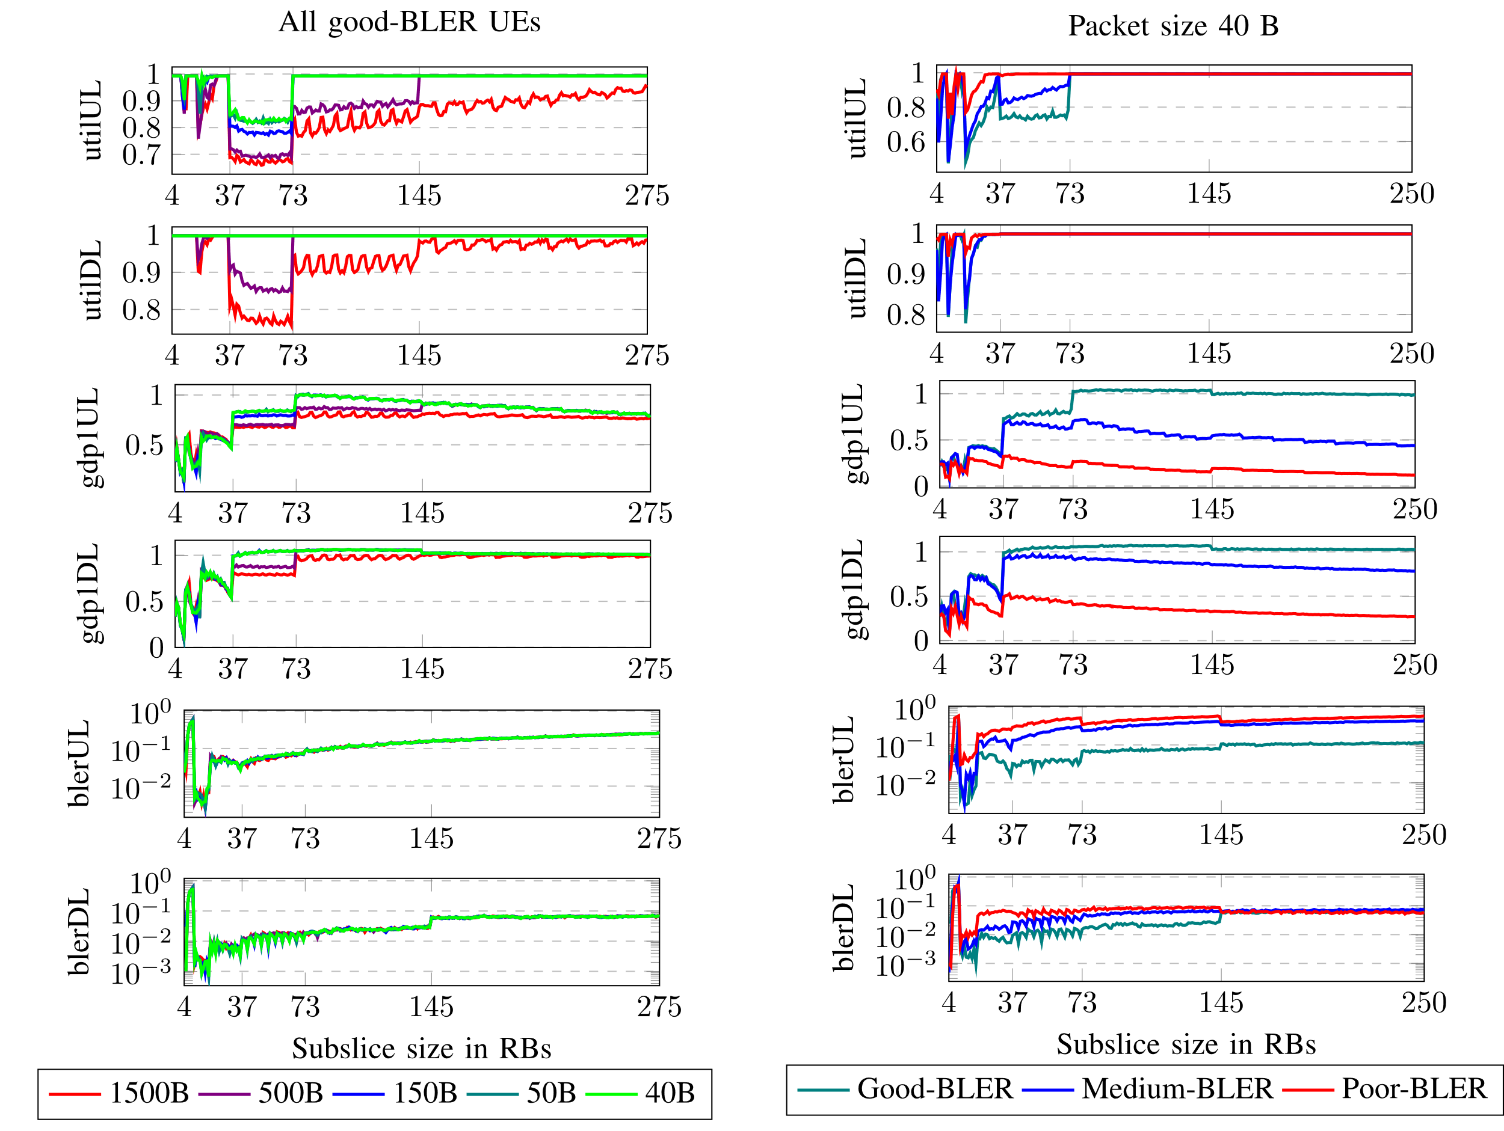
Contribution 2, results
Shorter packets, higher utilization
Higher BLER, higher utilization
Shorter packets, higher goodput
Lower BLER, higher goodput
BLER does not depend on packet size
BLER is the same for large subslices in DL

Slide 15
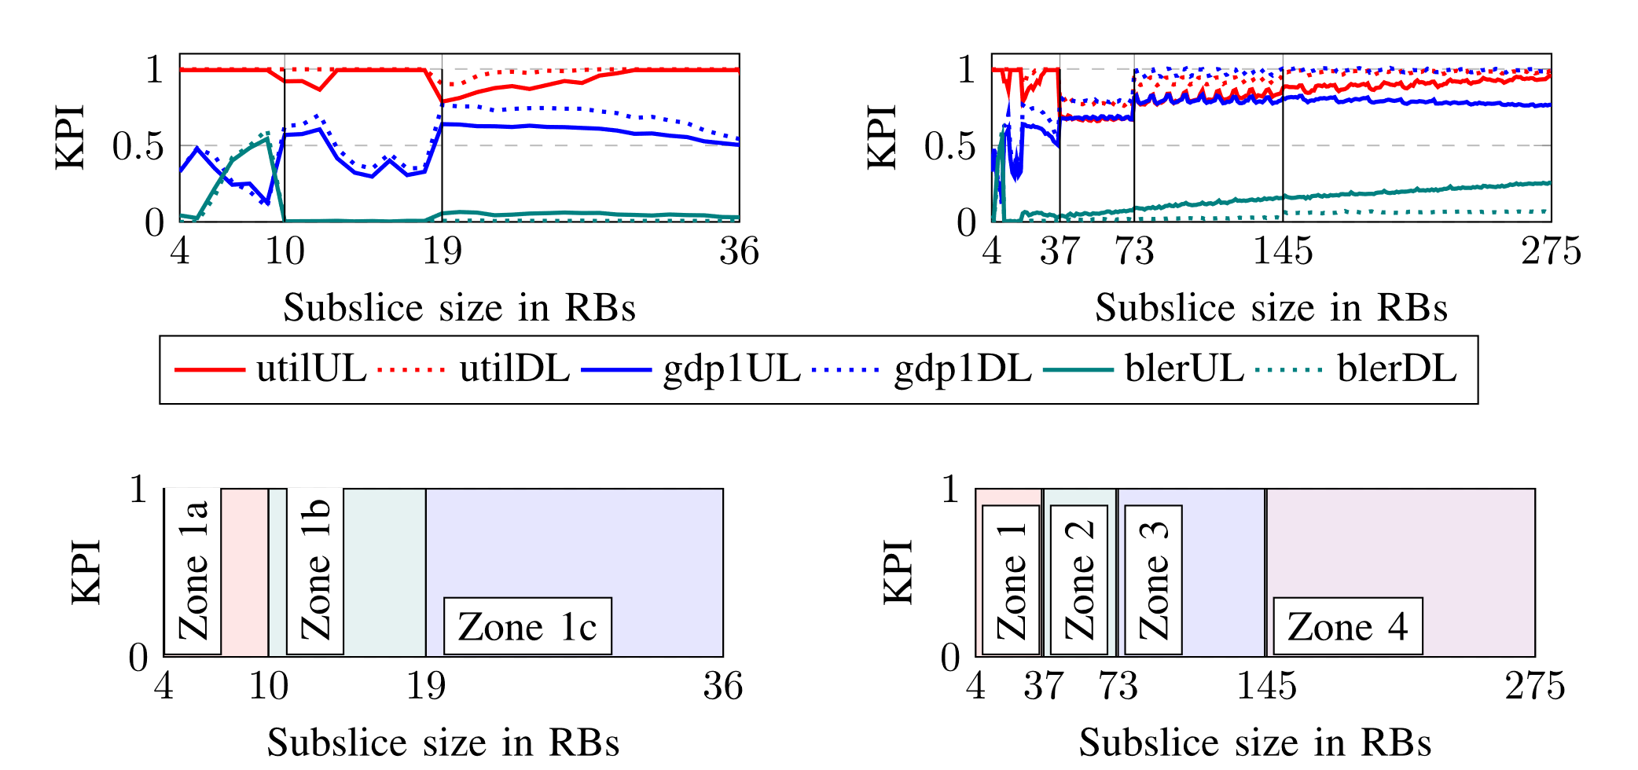
Contribution 2, findings
High utilization and higher goodput with higher BLER
High utilization, low goodput, high BLER
High utilization, low goodput and low BLER
Lowest utilization with reasonable goodput
High utilization, low goodput
High utilization and goodput

Slide 16
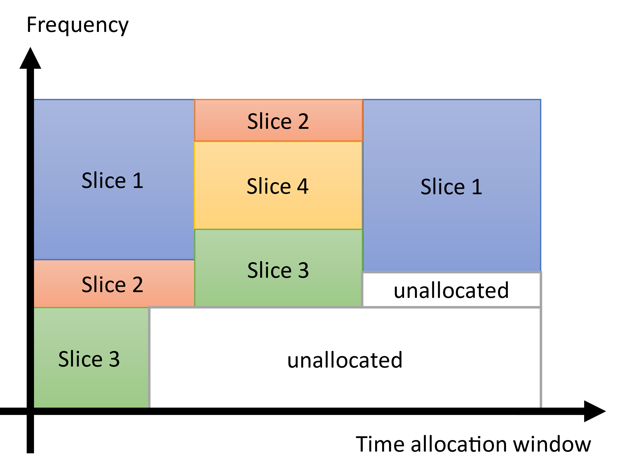
Contribution 3 (subslicing algorithm), related work
Subslicing in [84] by UE requirements has improved slice performance
  Number of subslices decided by quality of clusters not the capacity of the bandwidth resource
The [85] and [87] deal with radio resource partitioning in time-frequency plane to find largest unallocated space and achieve resource usage efficiency.
Research gap
  Subslicing with the purpose to improve slice performance is not done
Best BWP size for subslice?
[84] S. K. Singh, M. M. Salim, J. Cha, Y. Pan, and J. H. Park, “Machine Learning-Based Network Sub-Slicing Framework in a Sustainable 5G Environment,” Sustainability, vol. 12, no. 15, p. 6250, Aug. 2020, doi: 10.3390/su12156250.
[85] C. Y. Chang, N. Nikaein, and T. Spyropoulos, “Radio access network resource slicing for flexible service execution,” INFOCOM 2018 - IEEE Conf. Comput. Commun. Work., pp. 668–673, 2018, doi: 10.1109/INFCOMW.2018.8407021.
[87] I. Oussakel, P. Owezarski, P. Berthou, and L. Houssin, “Toward Radio Access Network Slicing Enforcement in Multi-cell 5G System,” J. Netw. Syst. Manag., vol. 31, no. 1, p. 8, Jan. 2023, doi: 10.1007/s10922-022-09694-0.

Slide 17
Contribution 3, method
Original k-means [114]
Given too small subslices exhibit poor performance, the minimum subslice size constraint introduced.
UEs are clustered using modified k-means with minimum cluster size requirement.
Bandwidth is subpartitioned.
Compare proposed subslicing by BLER with subslicing by rate and no subslicing.
C3
C1
C2
Proposed modified k-means
C3
C2
C1
[114] J. MacQueen, “Some Methods for Classification and Analysis of MultiVariate Observations,” in Proc of Berkeley Symposium on Mathematical Statistics & Probability, 1965, pp. 281–297.

Slide 18
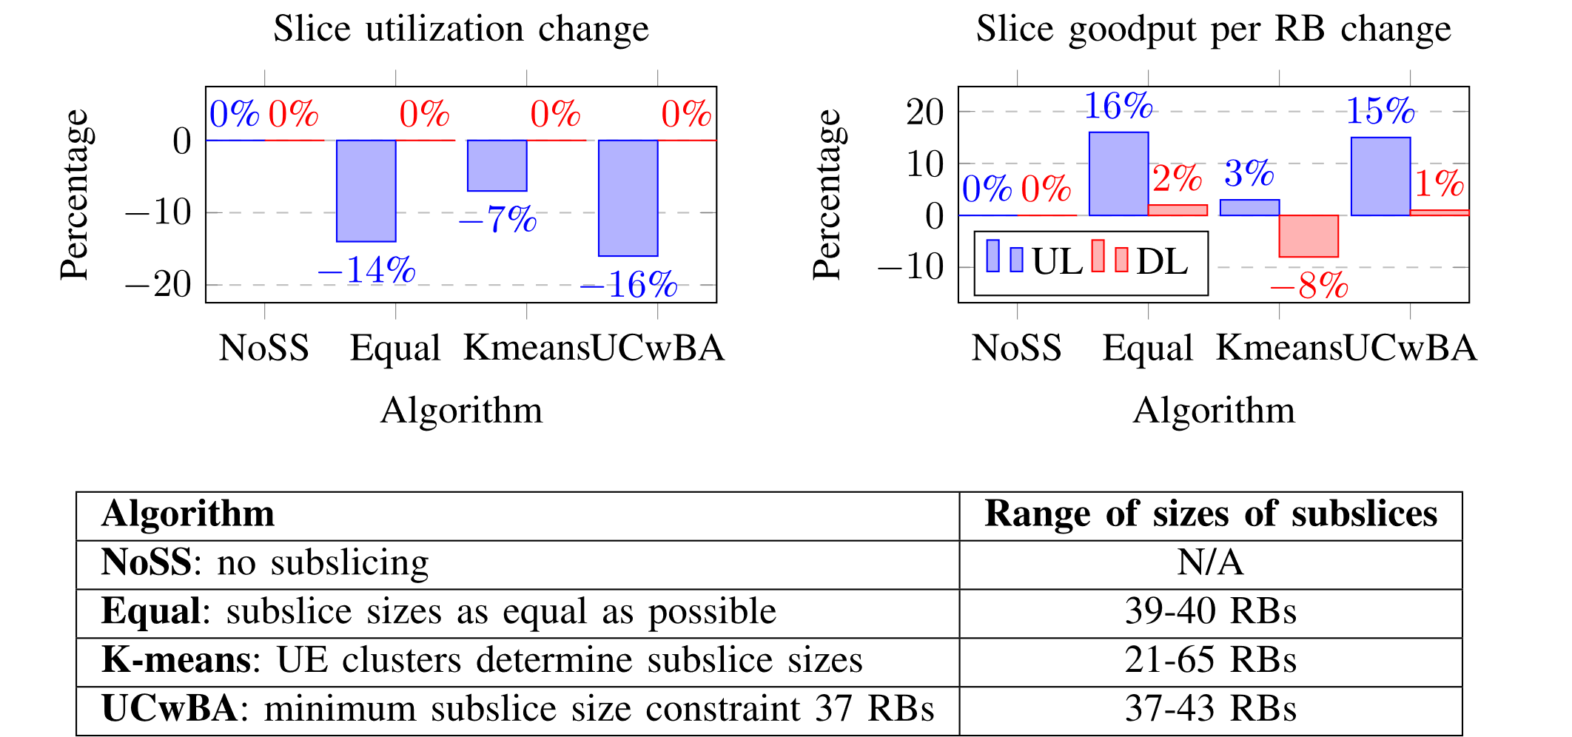
Contribution 3, results 1/3
Effect of minimum subslice size requirement
  Slice bandwidth is 275 RBs
  Slice contains 7 subslices
Larger subslices created using proposed algorithm have decreased slice utilization and increased slice goodput more

Slide 19
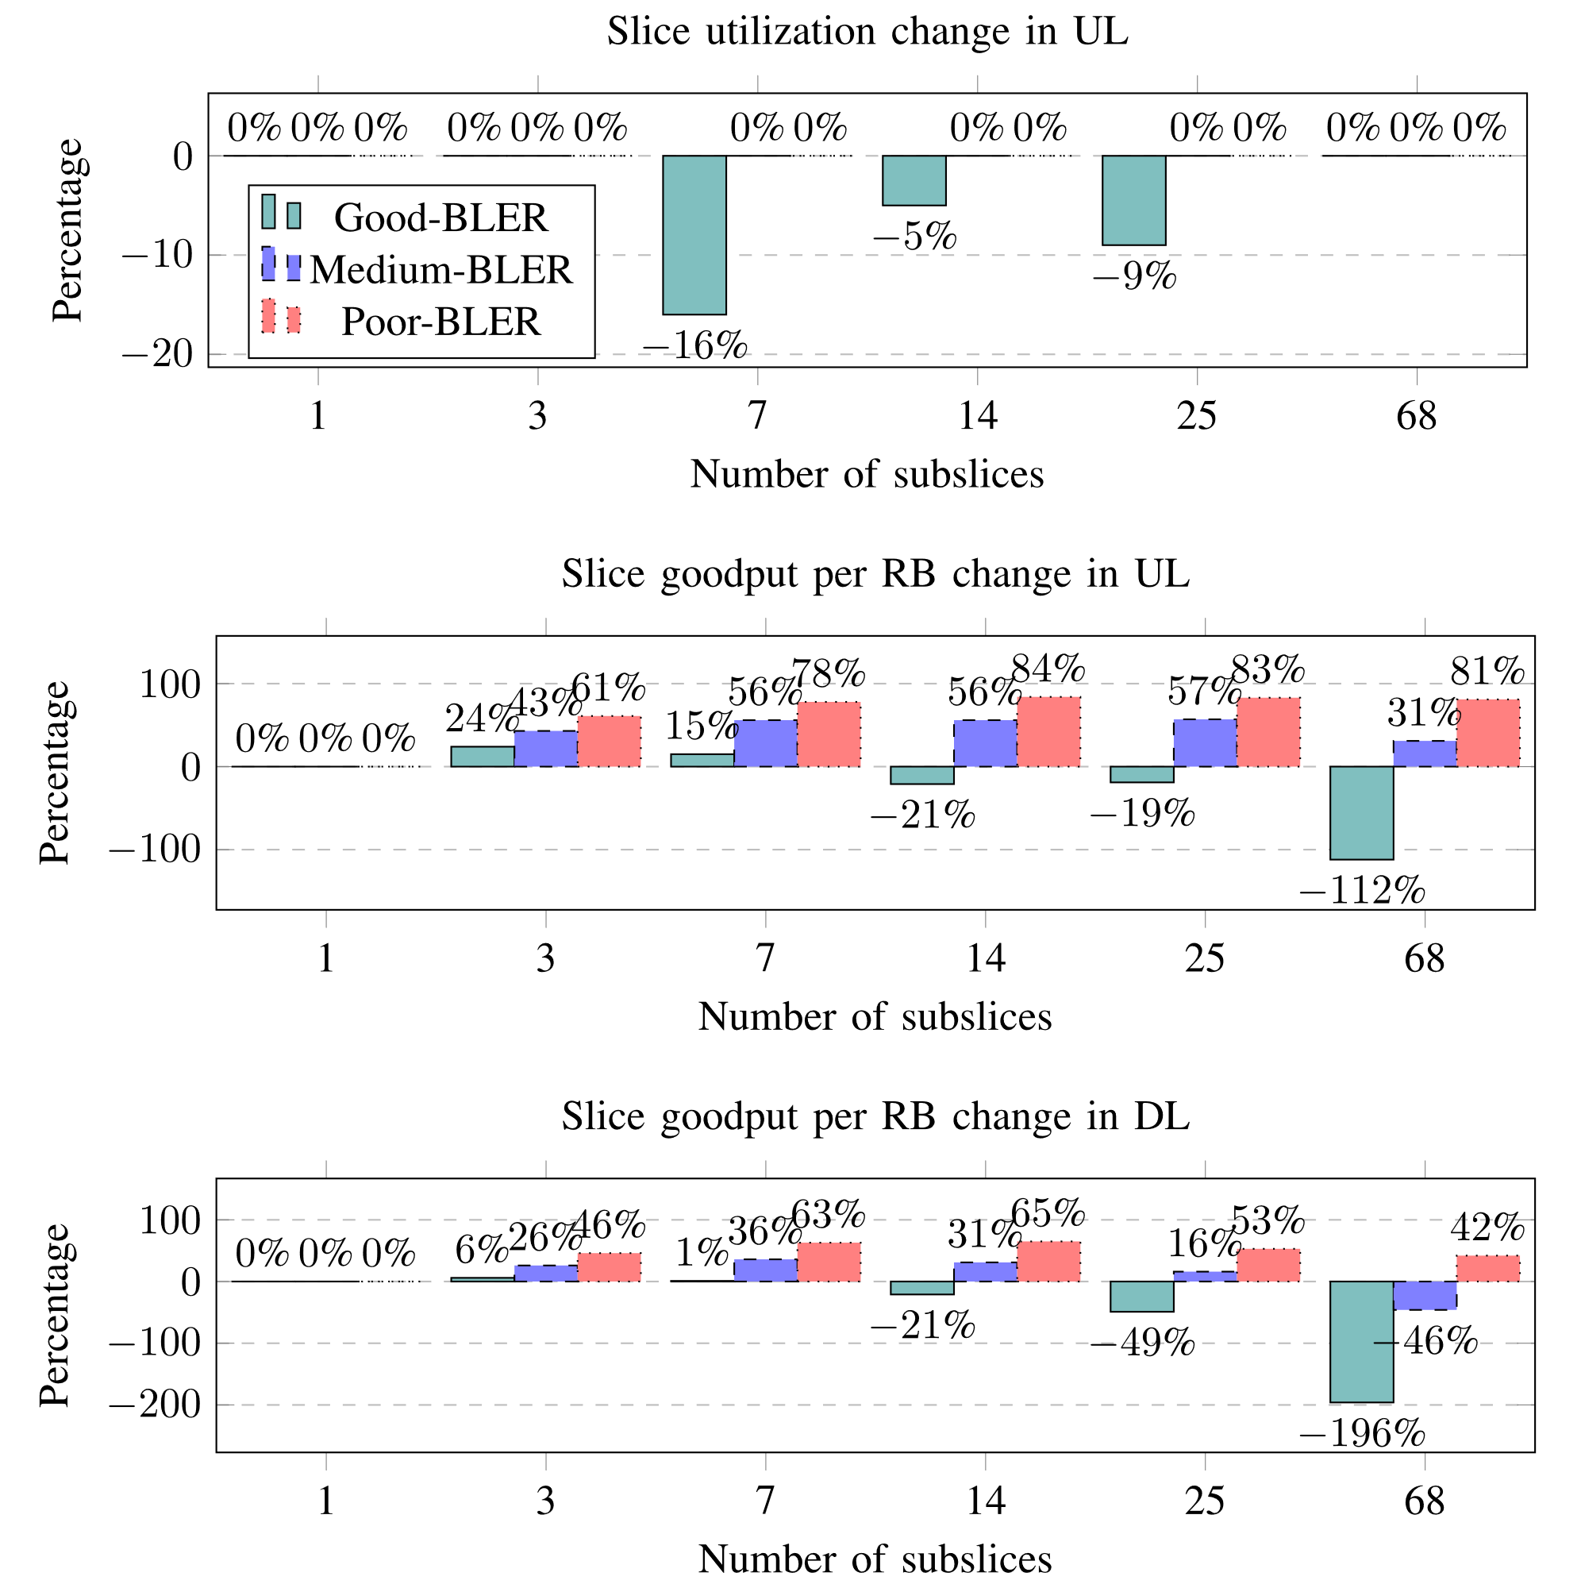
Contribution 3, results 2/3
Effect of subslicing to a slice containing UEs with different BLERs
  Slice bandwidth is 275 RBs
  Subslicing algorithm is UCwBA
Best performance achieved
  Good-BLER UEs:
    3 subslices (>73 RBs)
  Medium-BLER UEs:
    7 subslices (>37 RBs)
  Poor-BLER UEs:
    14 subslices (>19 RBs)
UCwBA – user clustering with bandwidth allocation (proposed subslicing algorithm)

Slide 20
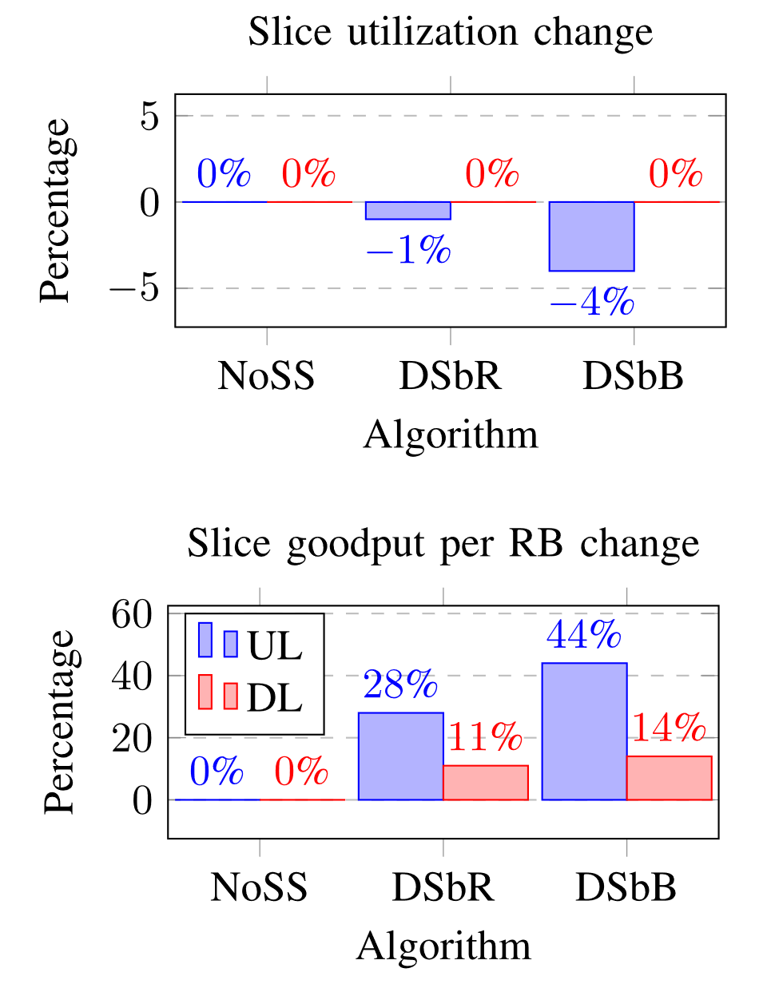
Contribution 3, results 3/3
Effect of UE clustering by rate and BLER
  Slice bandwidth 250 RBs
  Set of UEs
    UE requested rates [100 kbps, 200 kbps, 400 kbps]
    UE BLERs [good, medium, poor]
Subslicing by UE requested rate improved slice performance
Subslicing by UE achieved BLER improved slice performance more
NoSS – no subslicing
DSbR – dynamic subslicing by rate (based on state of the art)
DSbB – dynamic subslicing by BLER (proposed)

Slide 21
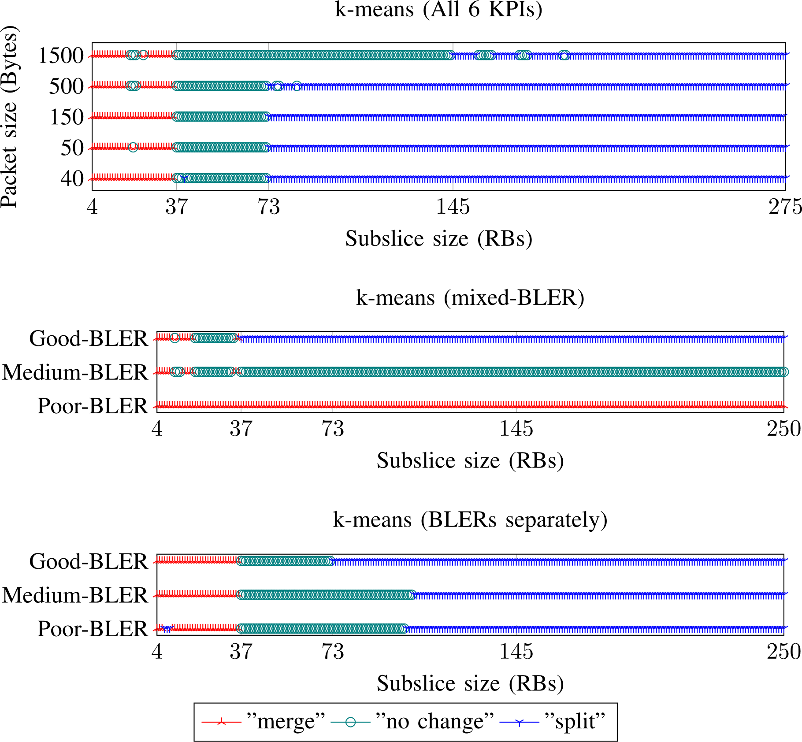
Contribution 4 (training data labeling), related work
All good-BLER UEs
[3] did performance data clustering, however this did not work when UE BLER was other than good
Research gap
  What if UE BLER is other than good?
However, smaller subslices exhibit better performance for poor-BLER UEs
However, best subslice sizes are smaller for UEs with BLER other than good
[3] M. Kulmar, I. Müürsepp, and M. M. Alam, “Enhanced Decision Mechanism for RAN Subslicing in Management Closed Control Loop,” in 2023 Eighth International Conference on Fog and Mobile Edge Computing (FMEC), IEEE, Sep. 2023, pp. 175–181. doi: 10.1109/FMEC59375.2023.10306223.

Slide 22
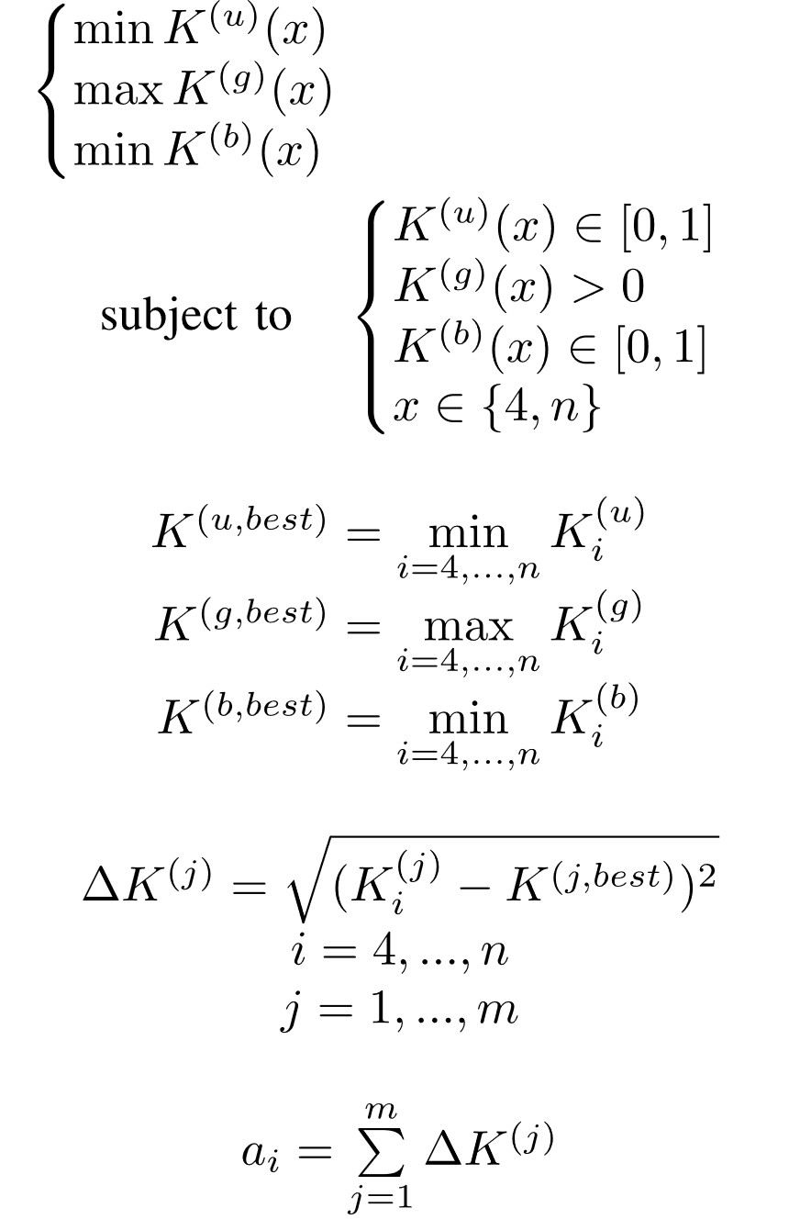
Contribution 4, method
Find subslice size with lowest utilization and BLER, and highest goodput per one RB
For each KPI calculate the best value of the data subset
For each subslice size calculate the RMSE from best value of the KPI
n – max number of slice RBs
Objective value for subslice size is sum of all KPI RMSEs
m – number of KPIs

Slide 23
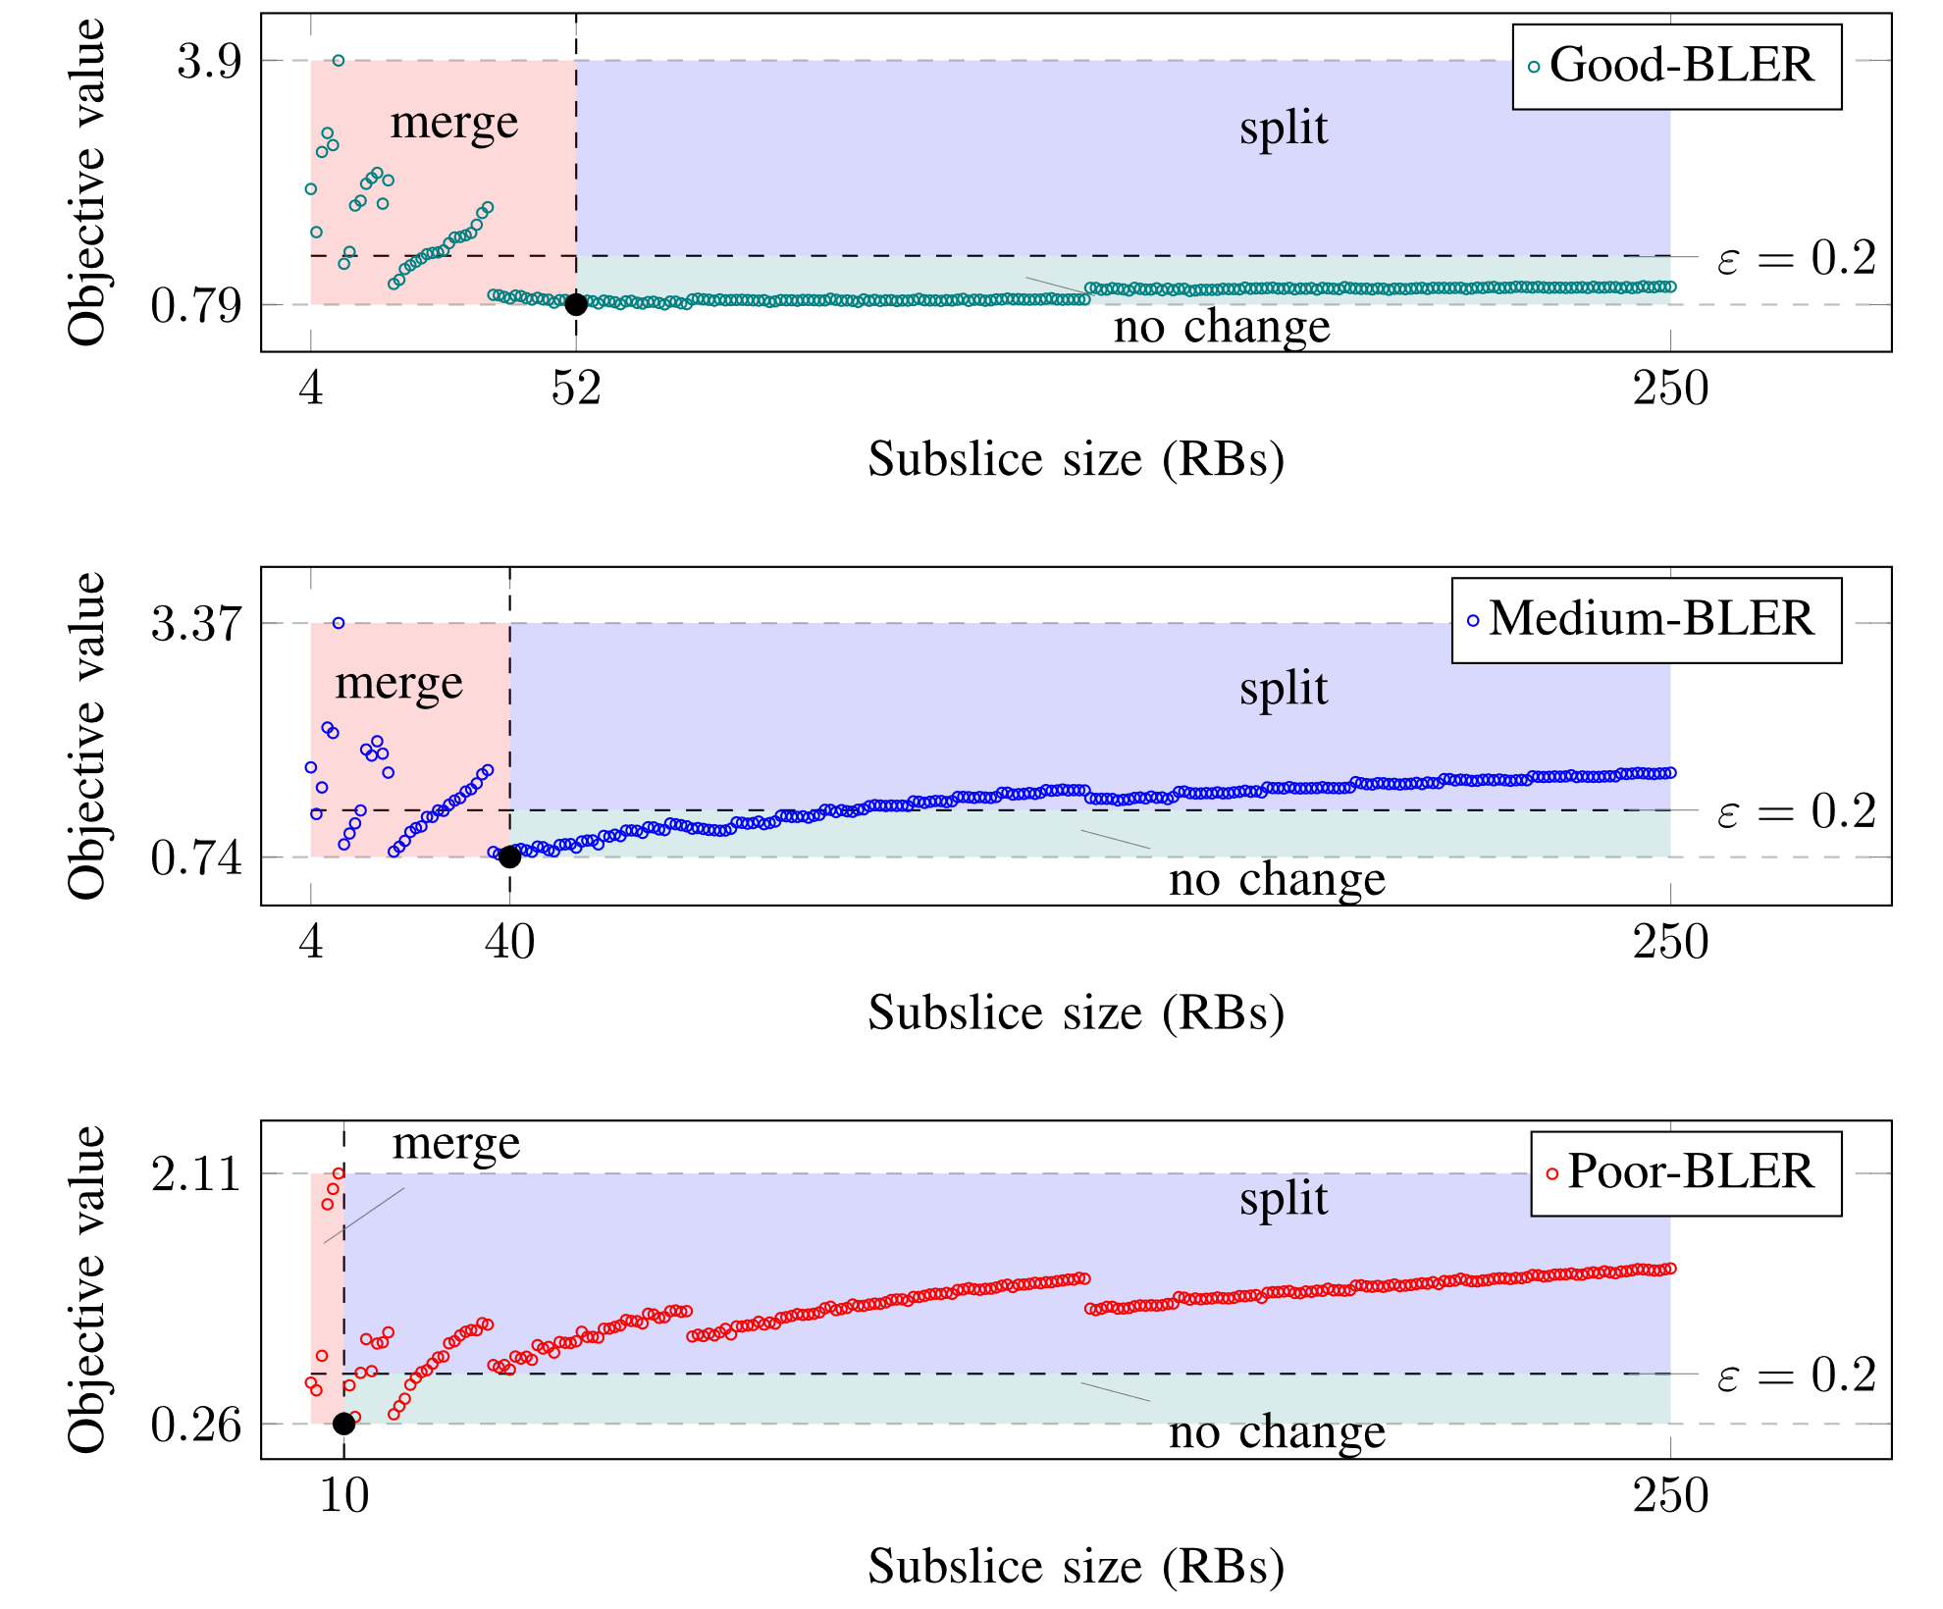
Contribution 4, results
Inputs
  6 KPIs: utilUL, utilDL, gdp1UL, gdp1DL, blerUL, blerDL
Output
  Decision: „split“, „merge“, „no change“
Find best subslice sizes for each BLER subset
Optimization
  Minimize utilization and BLER
  Maximize goodput per one RB

Slide 24
Contribution 5 (subslice processing) , related work
Automatic subslicing framework must
  evaluate the performance of slice and each subslice,
  decide reconfiguration, and
  reconfigure slice,
  if it will improve slice performance
MAPE-K [118] was selected
  Similar loop specified by 3GPP [31]
Research gap
  Automatic subslicing has not been done
Analyze
Plan (Decide)
Knowledge
Monitor
Execute
[31] 3GPP, “TS 28.535 - Management and orchestration; Management services for communication service assurance; Requirements,” 2020. [Online]. Available: https://www.3gpp.org/DynaReport/28535.htm
[118] J. O. Kephart and D. M. Chess, “The vision of autonomic computing,” Computer (Long. Beach. Calif)., vol. 36, no. 1, pp. 41–50, Jan. 2003, doi: 10.1109/MC.2003.1160055.

Slide 25
Contribution 5, method
Begin
Subslice id, UEs and RBs are not changed
Subslice processing algorithm →
Subslice splitting algorithm
  Minimum subslice size
    Select value from optimal sizes, which is not greater than current subslice size divided by 2
  Number of UE clusters: 2
  Cluster UEs by UE BLER using proposed modified k-means
Process subslices „no change“
The smallest is merged with the largest, pairwise;
If 3 subslices then all merged to one;
If 1 subslice, then it waits.
Process subslices „merge“
Each subslice split using proposed subslice splitting algorithm
Process subslices „split“
End

Slide 26
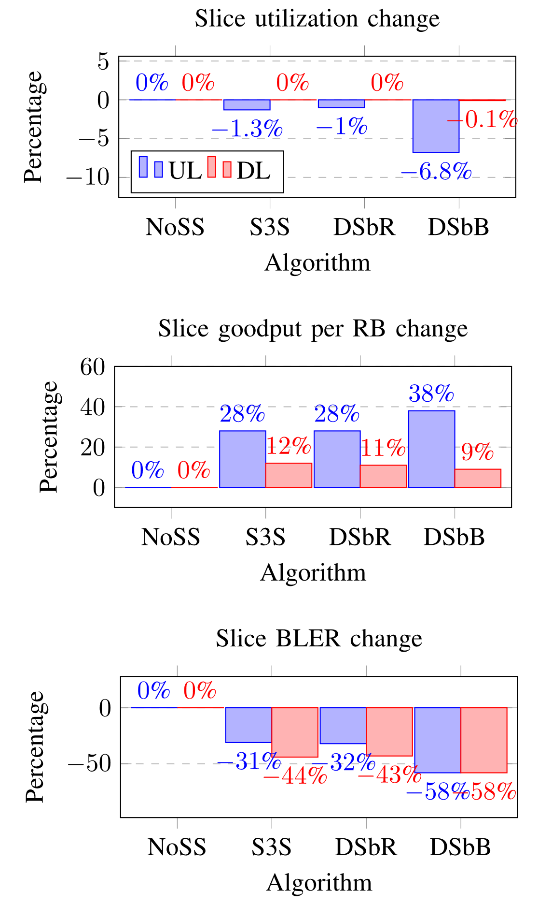
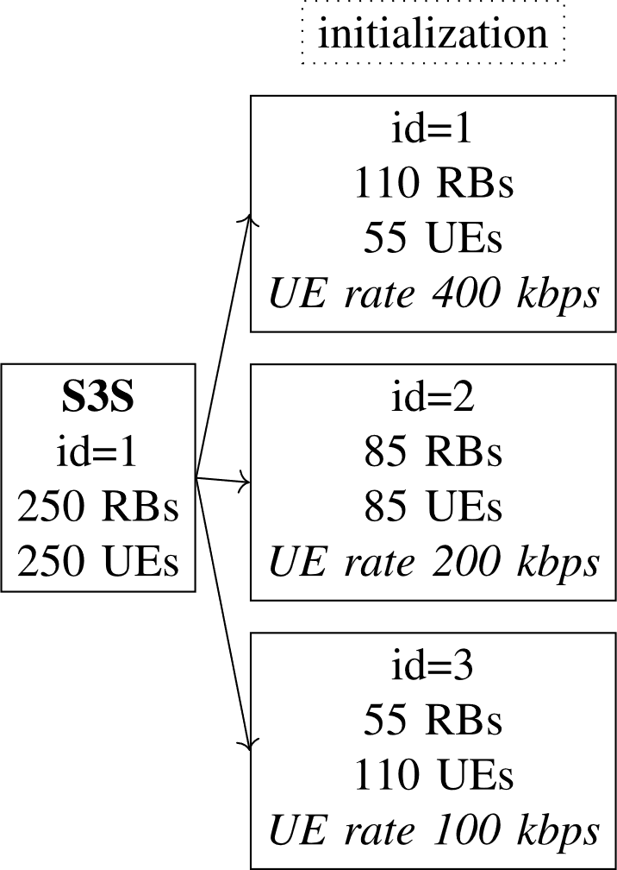
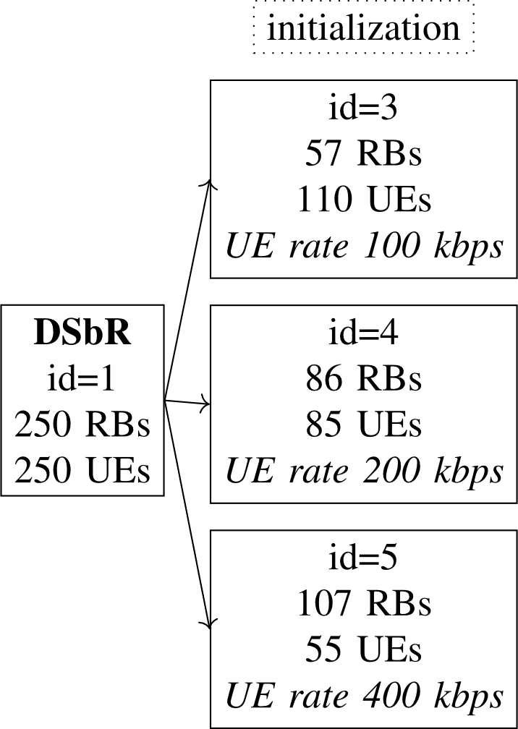
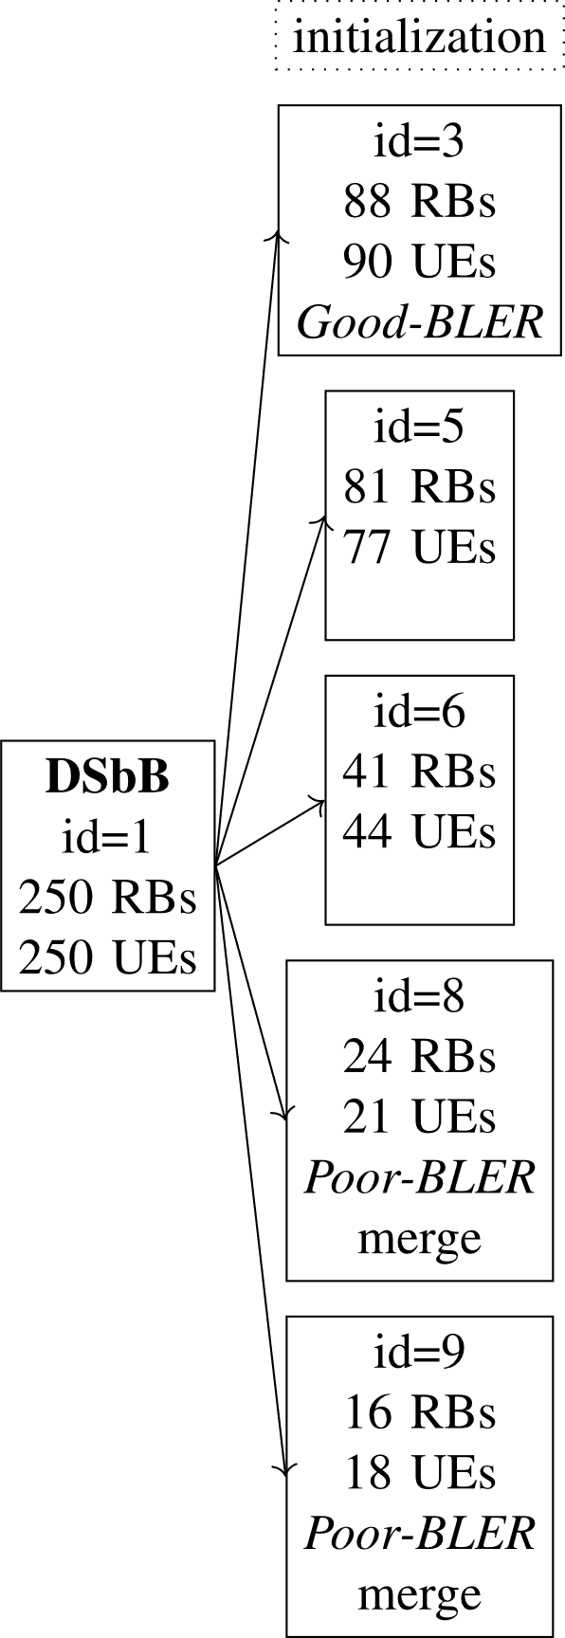
Contribution 5, results of initialization
1 iteration
2 iterations
4 iterations
DSbB has the highest decrease in utilization and BLER, and the highest increase in gooodput per one RB in UL
Infinite split-merge loop
NoSS – no subslicing
S3S – static 3 subslices (based on state of the art)
DSbR – dynamic subslicing by rate (based on state of the art)
DSbB – dynamic subslicing by BLER (proposed)

Slide 27
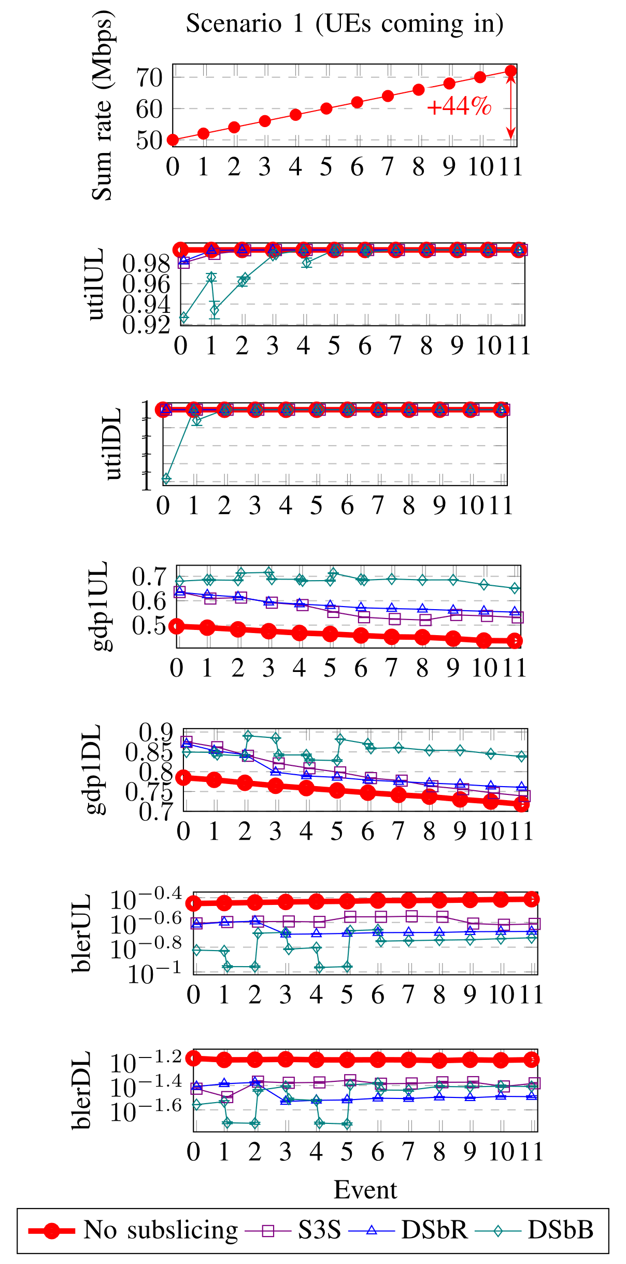
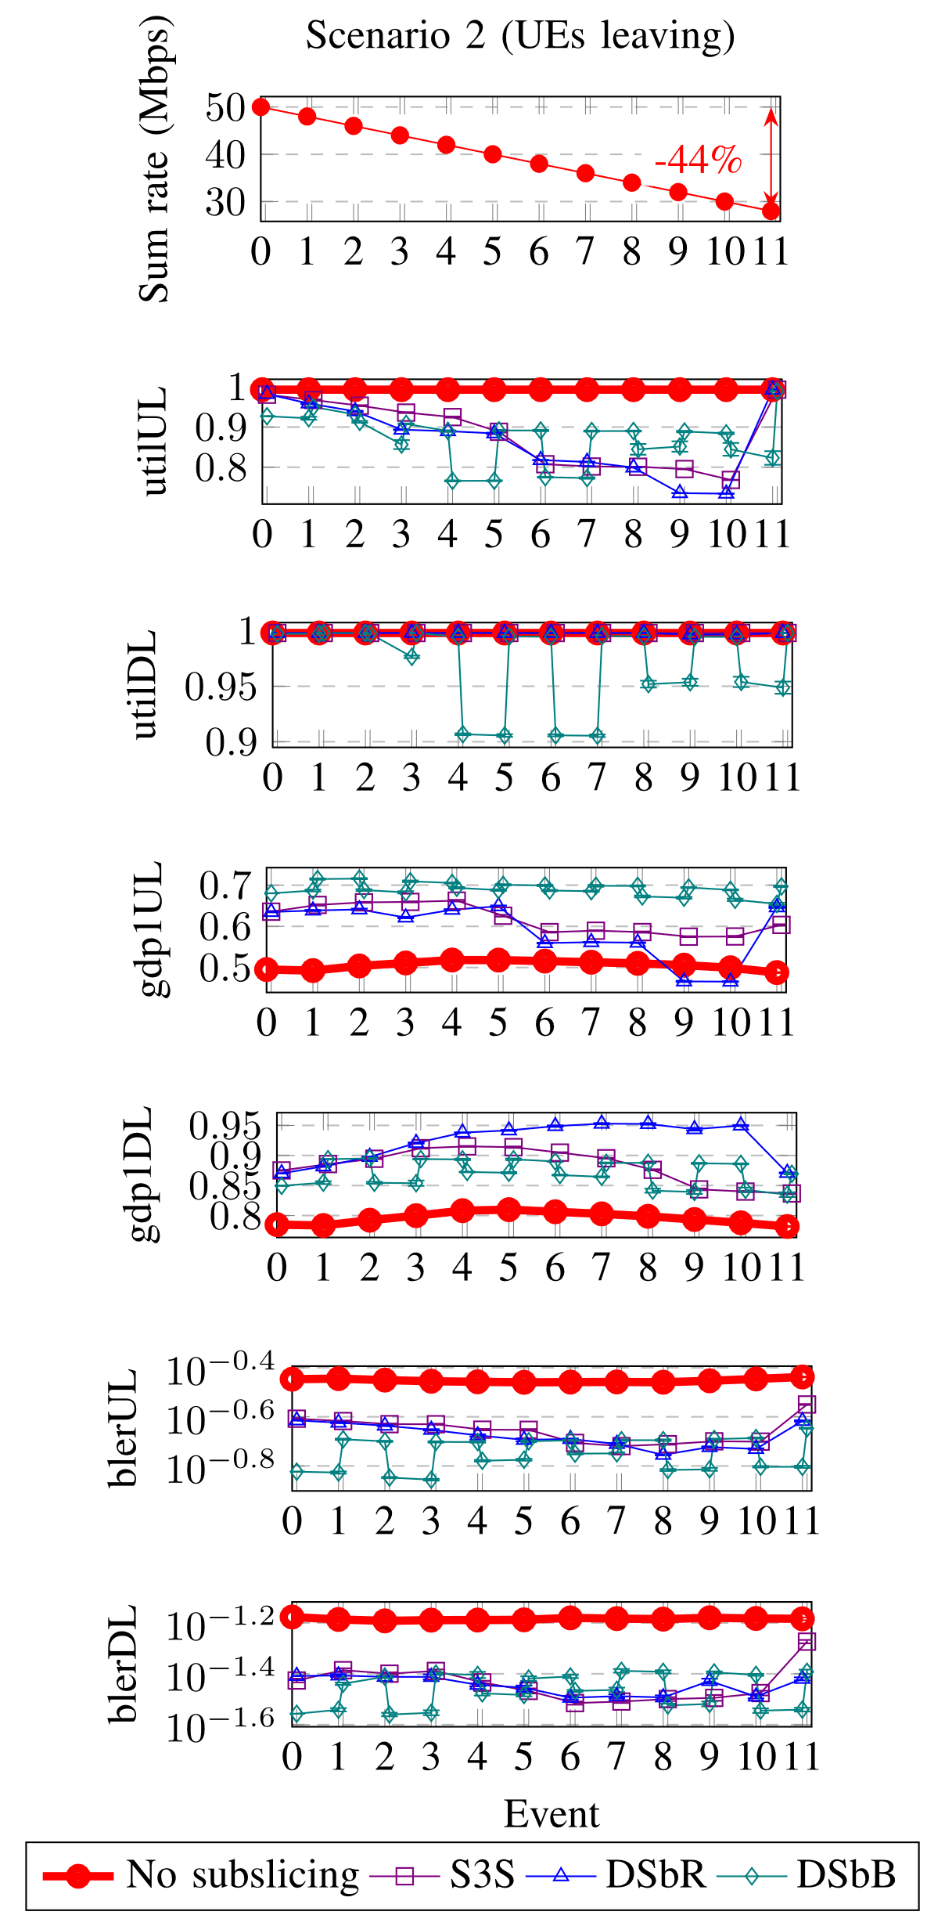
Contribution 5, results of runtime
At event 6 DSbR has one subslice with „merge“
At event 11 only 2 subslices for S3S and DSbR
At event 3 DSbR has one subslice with „merge“
At event 11 DSbR has 107 RBs not used
At event 8 DSbB has all subslices with „no change“
NoSS – no subslicing
S3S – static 3 subslices (based on state of the art)
DSbR – dynamic subslicing by rate (based on state of the art)
DSbB – dynamic subslicing by BLER (proposed)

Slide 28
Findings
„merge“→“no change“
DSbB achieves better slice performance than DSbR
DSbR needs less iterations to reach stable configuration (all subslice decisions „no change“)
Training data contains decisions for good-BLER, medium-BLER and poor-BLER UE sets.
  However, DSbR uses only medium-BLER training data subset
Limitations
  Single subslice waiting to be merged without the effect to slice performance
  Infinite loop of split-merge decisions with the effect to slice performance
If training data labeling will be adjusted then subslicing by BLER will improve slice performance

Slide 29
Conclusion
Investigated RAN slice performance dependence from slice size
Proposed subslicing based on the slice performance dependence on slice size to improve slice performance on fixed slice bandwidth.
  Slice UEs are grouped, and slice bandwidth divided to the UE groups.
  Slice bandwidth utilization has decreased, goodput per one RB increased and slice average UE BLER decreased.
Proposed subslicing by UE BLER, because poor-BLER UEs achieve better performance in smaller subslices
Proposed algorithms for Analyze, Decide (Plan) and Execute functions of the MAPE-K-type management closed control loop
  Automatic subslicing can improve slice performance on fixed slice bandwidth

Slide 30
Future work
Training data collection in actual RAN
  Investigation of dependencies between subslice size and performance
  Selection of UE requirements and capabilities to observe
Study latency as KPI
Training data labeling with multiple optimal BWP sizes:
  How to choose between them and how to reconfigure subslices of other sizes?

Slide 31
List of publications
M. Kulmar, I. Muursepp, and M. M. Alam, “The Impact of RAN Slice Bandwidth Subpartitioning on Slice Performance,” in 2022 Int. Wirel. Commun. Mob. Comput., IEEE, May 2022, pp. 419–424, ISBN: 978-1-6654-6749-0, DOI: 10.1109/IWCMC55113.2022.9825262
M. Kulmar, I. Müürsepp, and M. M. Alam, “Heuristic Radio Access Network Subslicing with User Clustering and Bandwidth Subpartitioning,” Sensors, vol. 23, no. 10, p. 4613, May 2023, ISSN: 1424-8220, DOI: 10.3390/s23104613
M. Kulmar, I. Müürsepp, and M. M. Alam, “Enhanced Decision Mechanism for RAN Subslicing in Management Closed Control Loop,” pp. 175–181, Sep. 2023, DOI: 10.1109/FMEC59375.2023.10306223
M. Kulmar, M. M. Alam, and I. Müürsepp, “Management Closed Control Loop Automation for Improved RAN Slice Performance by Subslicing,” TechRxiv. December 18, 2023, doi: 10.22541/techrxiv.170290948.88447519/v1. Under review

Slide 32
Thank you!

Slide 33
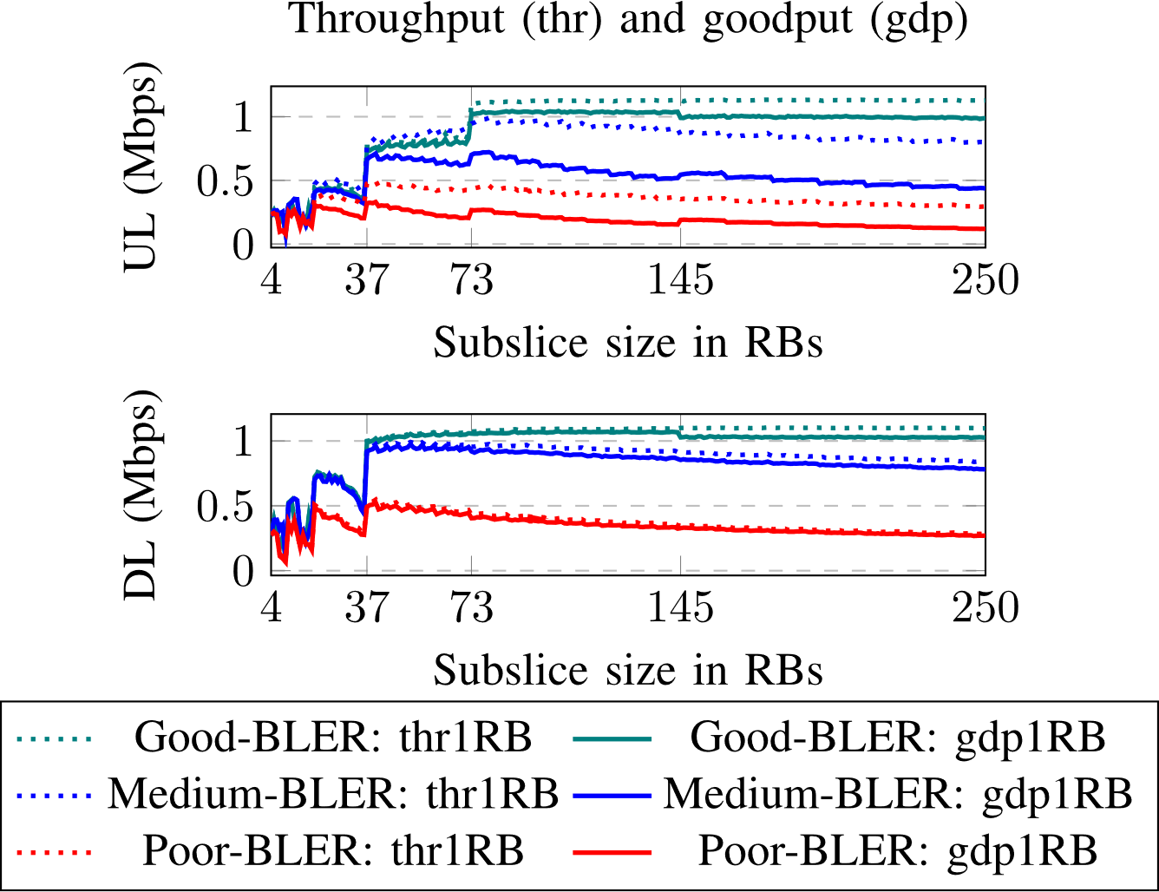
Bonus slide

Slide 34
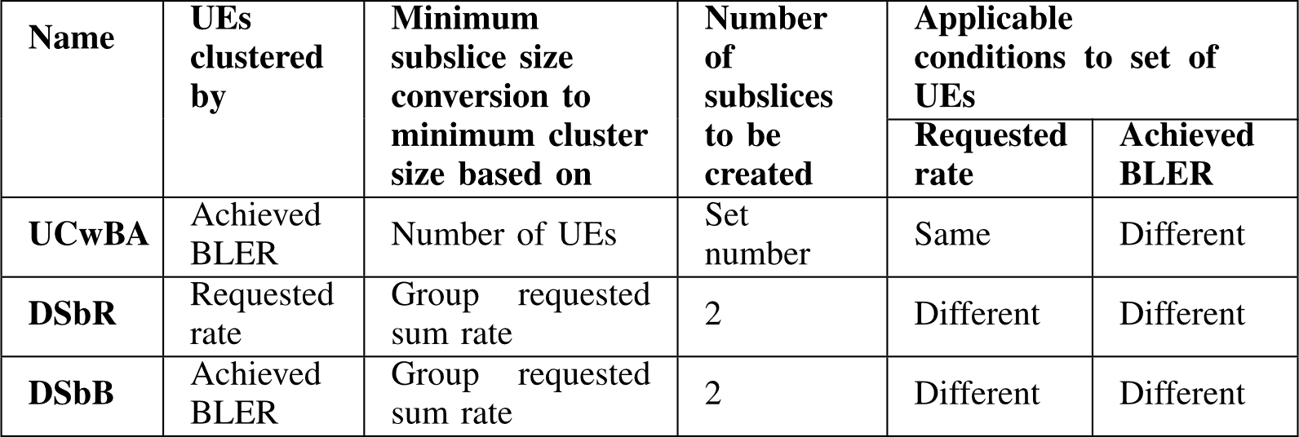
Summary of my proposed subslicing algorithms
All proposed subslicing algorithms use proposed modified k-means clustering with minimum subslice size constraint

Slide 35
Section 5.2: settings of NN could have been justified with more details
Are there similar implementations in the literature for the same type of problem?
Problem formulation
  learn classification dataset of 741 samples with 6 inputs and 3 outputs;
How to do 6 KPIs of performance data labeling for decisions „merge“, „split“ and „no change“?
To try settings for NN
  Training/validation/testing
  0.8/0.1/0.1
ML tools for RAN slicing:
  Long short term memory (LSTM)-based has longer training time than multilayer perception (MLP)-based [Benzaid2020]
  RNN has best classification accuracy; CNN-LSTM was 2nd best. Others were RNN, LSTM, Bi-LSTM. [IslamArif2022]
  RL (QL, A2C, RDL, double DQL, multi-agent RL) most generally applied for resource management and optimization. QL and A2C have long convergence time [Zhou2022]
[Benzaid2020] C. Benzaid and T. Taleb, “AI-Driven Zero Touch Network and Service Management in 5G and Beyond: Challenges and Research Directions,” IEEE Netw., vol. 34, no. 2, pp. 186–194, Mar. 2020, doi: 10.1109/MNET.001.1900252.
[IslamArif2022] M. A. Islam Arif, S. Kabir, M. F. Hussain Khan, S. Kumar Dey, and M. M. Rahman, “Machine Learning and Deep Learning Based Network Slicing Models for 5G Network,” in 2022 25th Int. Conf. Comput. Inf. Technol. (ICCIT), IEEE, Dec. 2022, pp. 96–101. doi: 10.1109/ICCIT57492.2022.10054696.
[Zhou2022] H. Zhou, M. Erol-Kantarci, and V. Poor, “Knowledge Transfer and Reuse: A Case Study of AI-enabled Resource Management in RAN Slicing,” IEEE Wirel. Commun., pp. 1–10, 2022, doi: 10.1109/MWC.004.2200025.

Slide 36
Update to Tab.2 in section 2.2.1
Paper, year | Scheduling level | Traffic direction | Transmit power management | SLA QoS requirements to be satisfied | Scope | Optimization goal
10.1109/TNSM.2022.3205415, 2022 | Both | DL | Yes | Rate, delay, power | Multiple O-RUs | Maximize sum rate of all UEs under QoS constraints
10.1109/TVT.2023.3327874, 2023 | Inter-slice | DL | No | E2E delay, inter-packet delay | Multiple overlapped cells | Optimal RB allocation
10.1007/s10922-022-09670-8, 2022 | Inter-slice | DL | No | Capacity, delay | One cell | Lower delay
10.1109/TWC.2023.3297014, 2023 | Both | UL | No | Throughput, latency, packet loss, | One cell with 6 interfering cells | Optimal RB allocation with SLA satisfied
10.1109/ACCESS.2023.3236103, 2023 | Inter-slice | DL | No | Guaranteed bit rate | Multiple cells | Minimize UE blocking probability
10.1109/TCCN.2022.3204572, 2022 | Both | DL | No | Throughput, delay | Multiple BSs | Maximize throughput for eMBB, minimize delay for URLLC
10.1109/TWC.2022.3171264, 2022 | Both | DL | Yes | Rate for eMBB, latency for URLLC | Single cell | Guarantee minimum rate for eMBB and guarantee latency for URLLC

Slide 37
Size of training dataset for NN in real systems
65000 samples [Thantharate2019]
458630 samples [84]
100 samples per service class 10.3390/fi15070247
Challenges with AI/ML [Thantharate2023]:
  Datasets from real life are not readily available.
  Insufficient dataset does not fit to real conditions
  Training on large dataset is costly.
[Thantharate2019] A. Thantharate, R. Paropkari, V. Walunj, and C. Beard, “DeepSlice: A Deep Learning Approach towards an Efficient and Reliable Network Slicing in 5G Networks,” in 2019 IEEE 10th Annu. Ubiquitous Comput. Electron. Mob. Commun. Conf. (UEMCON), IEEE, Oct. 2019, pp. 0762–0767. doi: 10.1109/UEMCON47517.2019.8993066.
[84] S. K. Singh, M. M. Salim, J. Cha, Y. Pan, and J. H. Park, “Machine Learning-Based Network Sub-Slicing Framework in a Sustainable 5G Environment,” Sustainability, vol. 12, no. 15, p. 6250, Aug. 2020, ISSN: 2071-1050, DOI: 10.3390/su12156250.
[Thantharate2023] A. Thantharate and C. Beard, “ADAPTIVE6G: Adaptive Resource Management for Network Slicing Architectures in Current 5G and Future 6G Systems,” J. Netw. Syst. Manag., vol. 31, no. 1, p. 9, Jan. 2023, doi: 10.1007/s10922-022-09693-1.

Slide 38
Radio resources
1 PRB contains
12 subcarriers
Operating band
(n1-n100)
contains BWPs
FR contains operating bands
1 BWP contains number of PRBs
Frequency
Resource blocks (RB) → subcarriers (frequency scale), symbols (time scale)
Scheduler allocates radio resources in 5G-NR
Cell uses BWP
Operating band can be assigned to network slice by GST
12
11
10
9
8
7
6
5
4
3
2
1
gNB handles many cells
1
2
3
4
5
6
7
8
9
10
11
12
13
14
Time
1 minislot contains 1, 2 or 4 symbols
Cell carrier is the center frequency of BWP used by that cell
1 slot contains 12 or 14 symbols, depends on prefix used
1 subframe contains slots, count of slots depends on SCS
1 frame contains 10 subframes
The duration of 1 frame is 10 ms

Slide 39
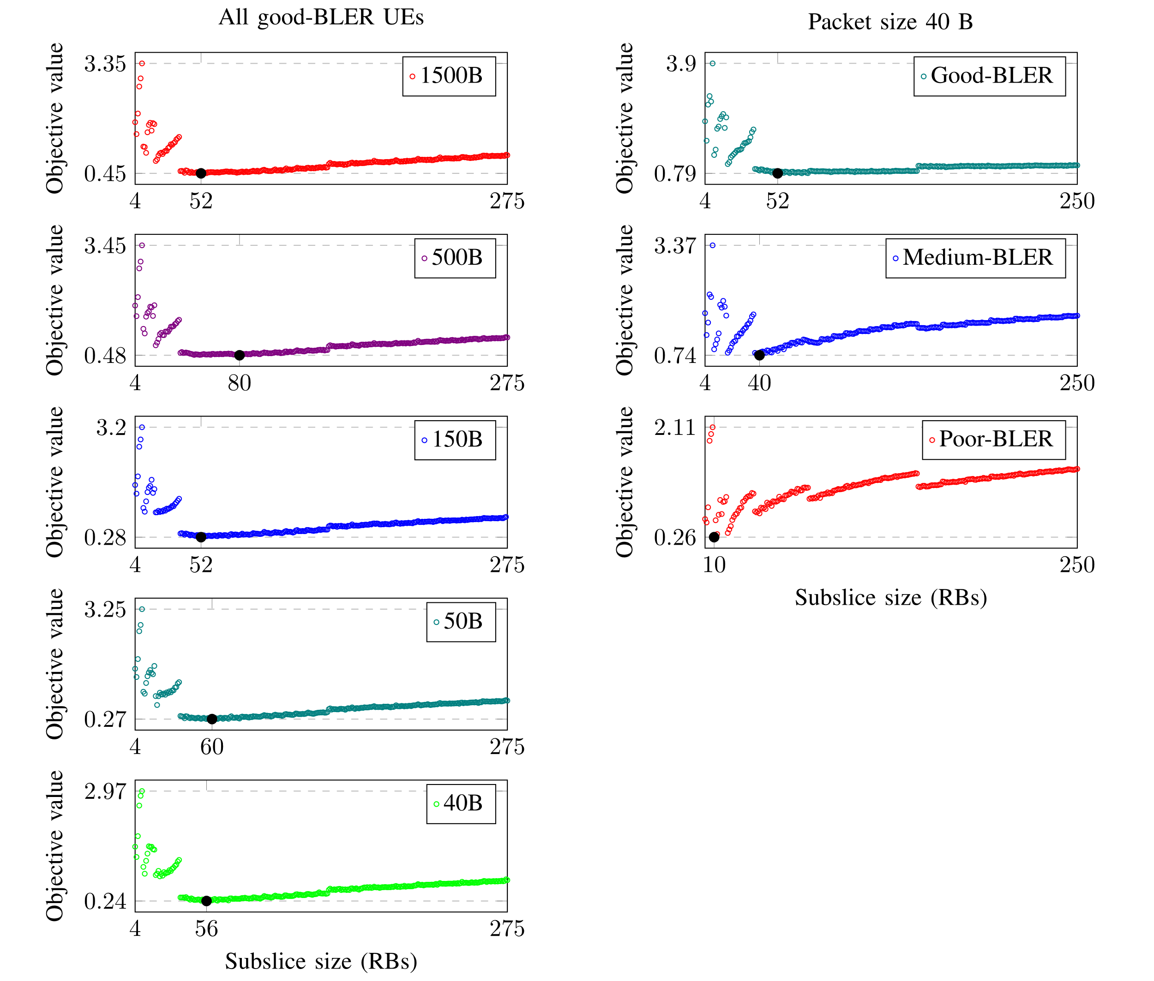
Optimal subslice sizes for each data subset results
Good subslice sizes are not less than 37 RBs
Smaller subslices are better when BLER is worse

Slide 40
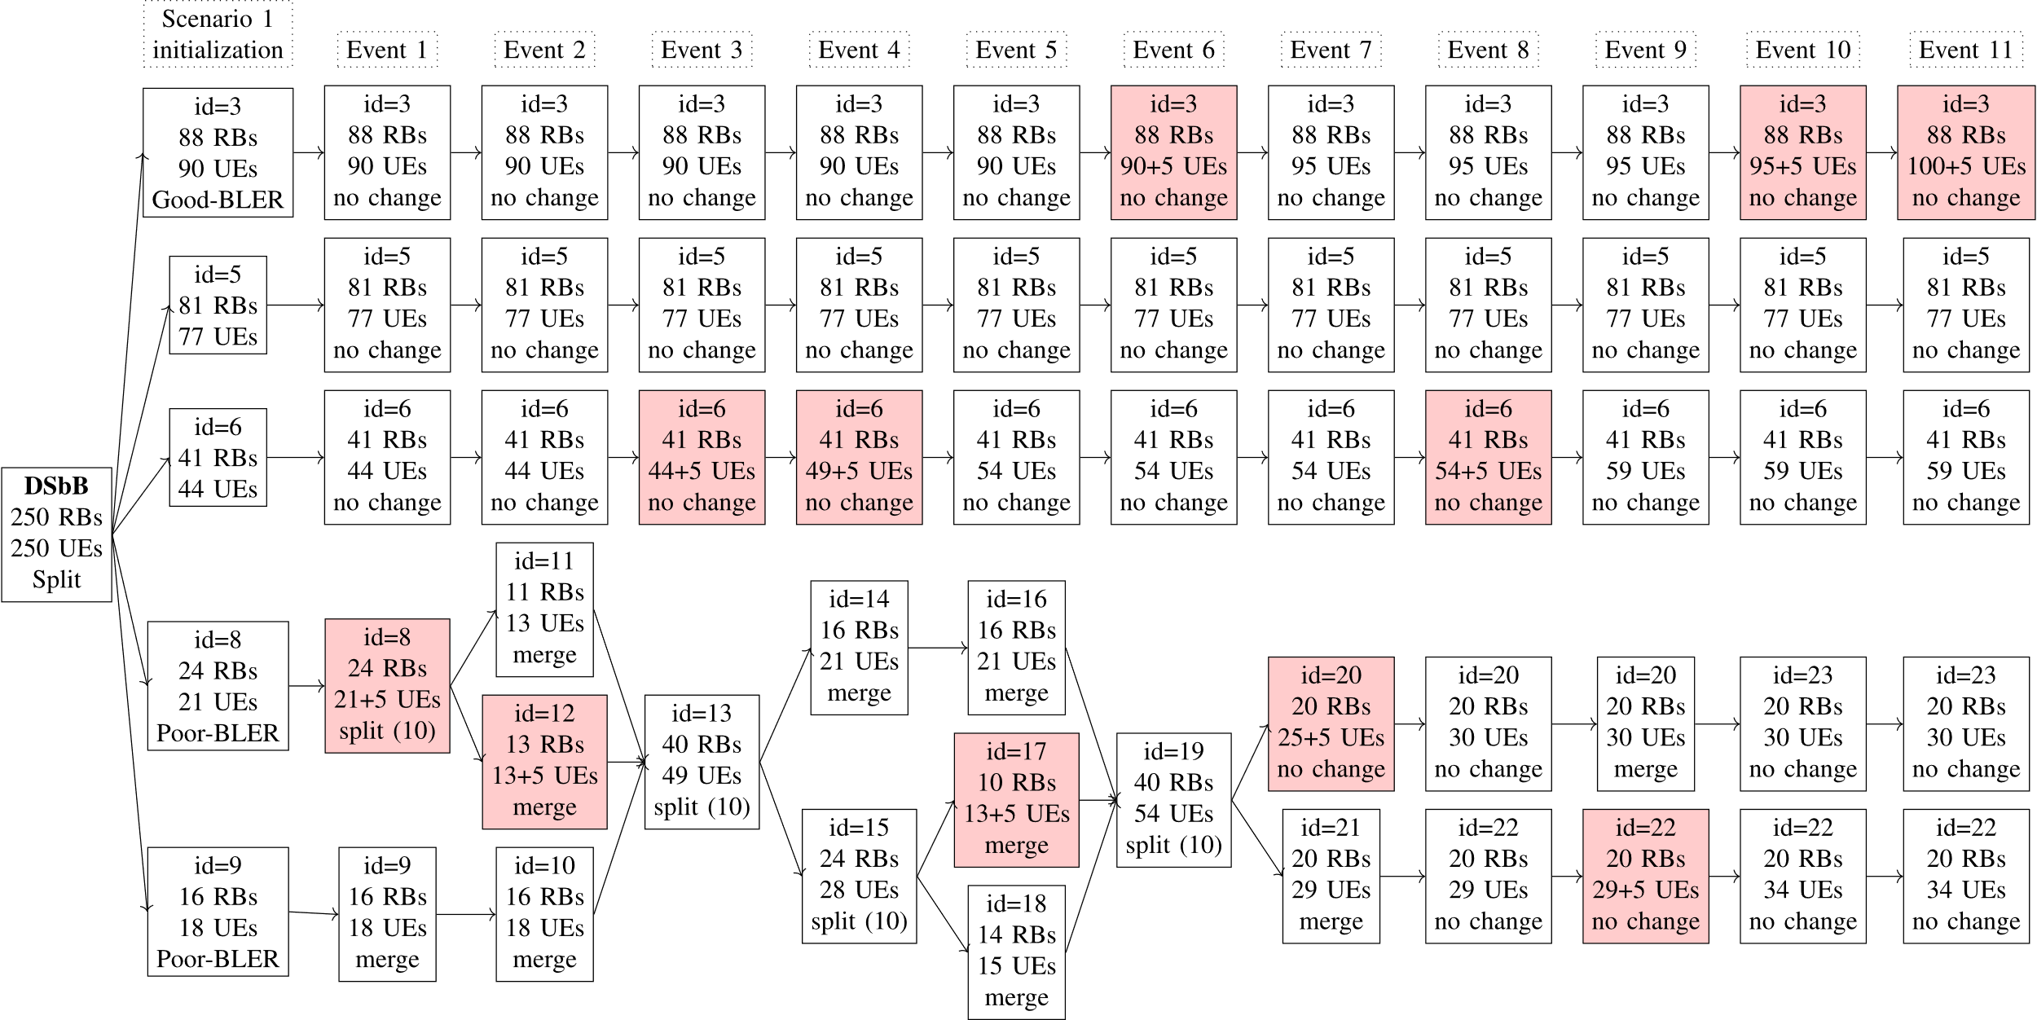
Read slice configuration figures (Scenario 1, DSbB)

Slide 41
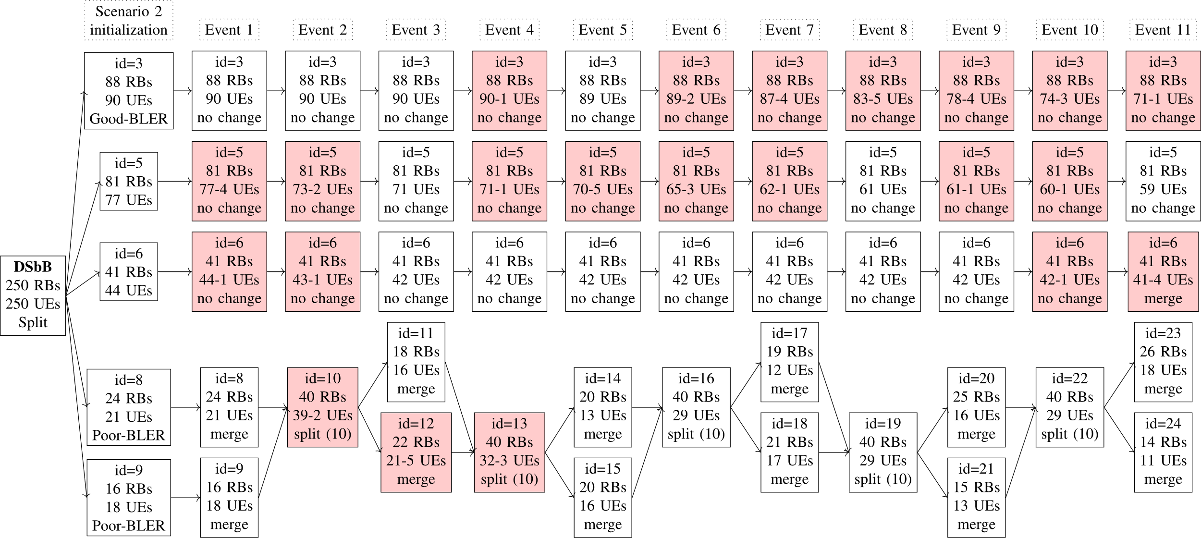
Read slice configuration figures (Scenario 2, DSbB)

