Slide 1

Congruence and friction between teachers’ intentions and students’ perceptions of CBL courses
K. Helker, S. Michel, M. Bots, P. Mottl, A. Michelson
SEFI conference 2023

Slide 2
Introduction
Current challenges call for innovative educational concepts
Social, economic, environmental, and medical challenges are complex, open-ended and ill-defined (Gomez-Puente et al., 2013)
Call for modern learning environments using authentic challenges and offer opportunities cooperative learning (Dochy et al. 2003, 534)
Challenge-based learning (CBL)
CBL has become popular in engineering education (Gallagher & Savage 2021; Doulougeri et al. 2021)
CBL implementation can vary considerably between contexts (van de Beemt et al., 2022)
Congruence between student’s and teacher’s perception of learning environments can benefit optimal teaching-learning processes (Königs et al., 2014)

Slide 3
Introduction
Goal of the study
Describe how teachers' intent to implement CBL at four European universities
1
How this intention corresponds with students' perceptions during CBL course participation
2

Slide 4
Challenge-Based Learning
CBL as an evolution of other constructivist educational concepts incorporating active learning
“learning while solving real-world challenges”
(Nicols et al., 2016, p. 6)
“[...] where the learning takes places through the identification, analysis and design of a solution to a sociotechnical problem. The learning experience is typically multidisciplinary, takes place in an international context and aims to find a collaboratively developed solution, which is environmentally, socially and economically sustainable.”
(Malmqvist, et al., 2015, p. 4)
“In CBL, student learning centers on an open ended, real-life challenge for which a community of external stakeholders (companies, governments, knowledge institutions and/or citizens) seeks a solution.”
(Bombaerts et al., 2021, p. 48)

Slide 5
Implementation of CBL
CBL can take many different forms but mostly involves:
      Active &
      self-regulated learning
      Learning is key:
      Focus on the process
      Open-ended challenges
      (outcome is not pre-defined)
      Further stakeholders
      Collaboration – integration and
      synthesis of perspectives
      (and disciplines if interdisciplinary CBL)
      Students define the specific problem themselves
Notes:
Gallagher & Savage (2020):
Commonly agreed charactertstics of CBL: global themes, real-world challenges, collaboration between students, academic and extra-academic actors, technology, flexibility, multidisciplinarity and discipline specificity, innovation and creativity, challenge definition
Leijon et al (2021): “map research on Challenge-Based Learning in HE between 2009 and 2020 with focus on the following research questions: What research has been published? How is CBL defined in HE settings in relation to the definition by Apple? How is CBL in HE grounded scientifically in the research?”
Van den Beemt et al. (2022): Three concepts: Vision of CBL, learning and teaching, support. Each of these dimensions can be described by a number of indicators that can be scored for a course

Slide 6
Implementation of CBL
CBL implementation can vary considerably between contexts, depending on specific aims
Identify commonly agreed characteristics of CBL
(Gallagher & Savage, 2020)
CBL implementation
Map research on CBL in HE and definitions of CBL
(Leijon et al., 2021)
CBL compass to capture variety of implementation
(Van den Beemt et al., 2022)
Notes:
Gallagher & Savage (2020):
Commonly agreed charactertstics of CBL: global themes, real-world challenges, collaboration between students, academic and extra-academic actors, technology, flexibility, multidisciplinarity and discipline specificity, innovation and creativity, challenge definition
Leijon et al (2021): “map research on Challenge-Based Learning in HE between 2009 and 2020 with focus on the following research questions: What research has been published? How is CBL defined in HE settings in relation to the definition by Apple? How is CBL in HE grounded scientifically in the research?”
Van den Beemt et al. (2022): Three concepts: Vision of CBL, learning and teaching, support. Each of these dimensions can be described by a number of indicators that can be scored for a course

Slide 7
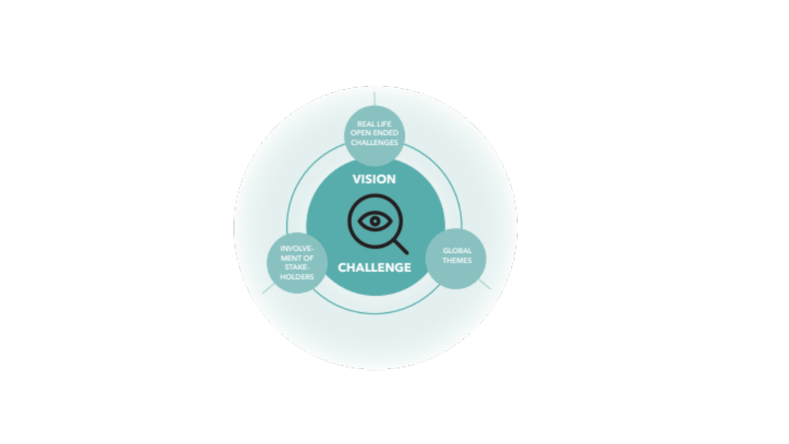
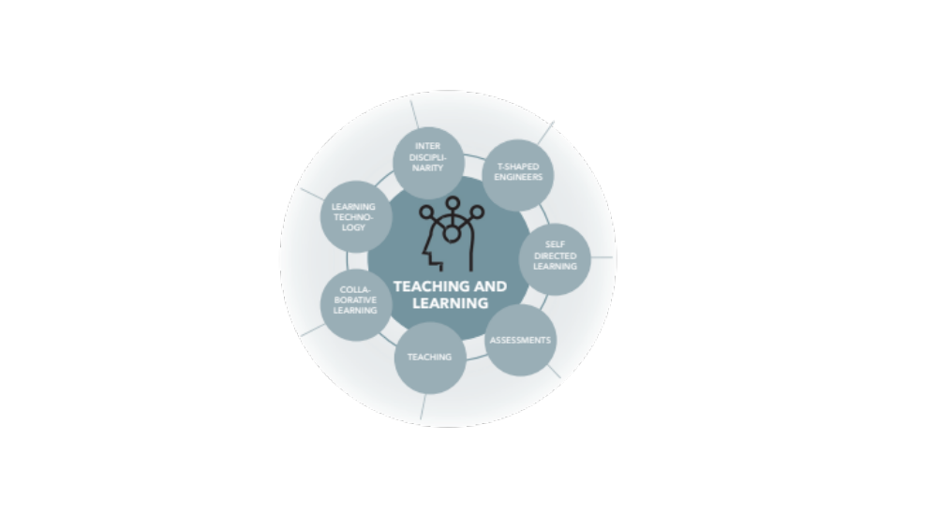
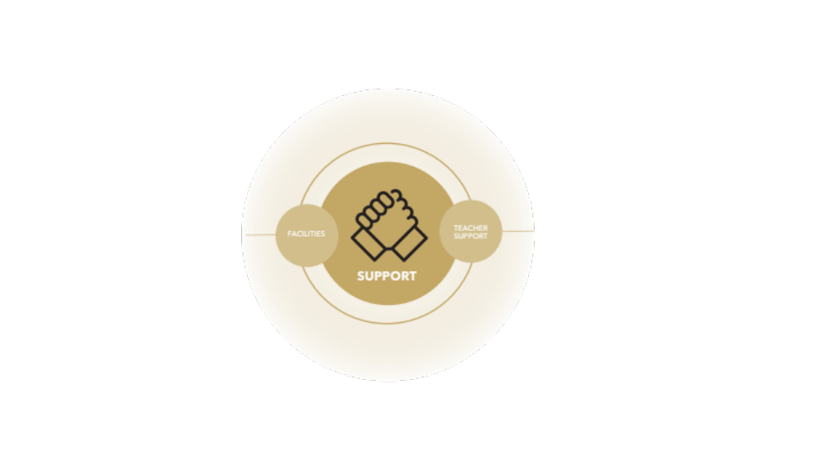
Implementation of CBL
CBL compass (Van de Beemt et al., 2022)
Three categories with specific dimensions: Vision of CBL, learning and teaching, support.
Each of these dimensions can be described by a number of indicators that can be scored for a course.
Van den Beemt et al., 2020, 2021

Slide 8
Convergence and Frictions
Teachers and students can differ in their perceptions of the same learning environment (Den Brok et al. 2006)
Limited knowledge of teachers about perspectives of their students (Doppelt 2004; Watkins 2004)
Congruence between teachers’ and students’ perceptions of a learning environment is central for an optimal teaching-learning process.” (Königs et al., 2014)
  → Incongruence in perception = friction (Vermunt and Verloop 1999)
Consequences of friction according to Königs et al. (2014):
Incongruent behavior not directed to the some goals → effectiveness of teaching (Vermetten et al. 2002)
Negative effect on student self-efficacy, intrinsic interest, commitment, and productivity (Eccles et al. 1993; Renzulli and Dai 2001; Seidel 2006).

Slide 9
Research Questions
Goal of the study: Describe how teachers intent to implement CBL at four European universities and how this intention corresponds with students' perceptions during CBL course participation.
Research Questions:
A
    1: How do teachers (intend to) implement the CBL courses?
    2: How do students perceive the implementation of the CBL courses?
B
    3: Do students view differ from teachers’ intentions?
C

Slide 10
Methods: Sample
Teachers (n = 4) and students (n = 55) involved in the EuroTeQ Collider from 4 technical universities across Europe
  Joint CBL-initiative of the EuroTeQ Engineering University
  Joint theme “Leave no waste behind”
  Comparable learning objectives and advertisement of the course
  Variance in implementation of the courses (e.g. duration, number of participants)
    Course 1: 1 week
    Course 2: 16 week
    Course 3: 8 week
    Course 4: 8 week
Table 1. Student sample per course
 | # students | gender |  |  | Study level |  |  | Field of study
 |  | m | f | d/na | Bachelor | Master | PhD | E | I | B | S | O
Course 1 | 13 | 3 | 9 | 1 | 10 | 2 | - | 5 | 6 | - | - | 5
Course 2 | 6 | 2 | 6 | - | - | 5 | 1 | - | 3 | - | 1 | 1
Course 3 | 9 | 8 | 1 | - | 4 | 5 | - | 6 | 2 | 1 | 2 | -
Course 4 | 27 | 19 | 7 | - | - | 26 | 8 | 8 | 1 | 11 | 6 | 7
Notes. Field of study: E = Engineering, I = Informatics and computer science, B = Business and Economics, S = Social Science, O = Other. The selection of more than one study program was possible.

Slide 11
Methods: Procedure and Instruments
Teacher interviews: CBL compass tool (van de Beemt et al., 2023)
1 = Not implemented
4= fully implemented
Instrument to examine CBL course designs based on three categories of dimensions
4-point rating scale
General information about course implementation
Data collection in the beginning of the course
    Vision (8 indicators): e.g. the extent to which CBL experiments employ real-life open-ended challenges
    Teaching and learning (23 indicators): e.g. aim for educating T-shaped engineers
    Support (5 indicators): e.g. Support structures for teachers to develop their coaching skills

Slide 12
Methods: Procedure and Instruments
Student survey: Student compass (Recently developed at TU/e)
Standardized scales to examine students' perspective on course design and implementation
Analogous set-up to CBL compass in the teacher's version
  12 indicators
4-Point rating scales
Data collection between middle and end of the course

Slide 13
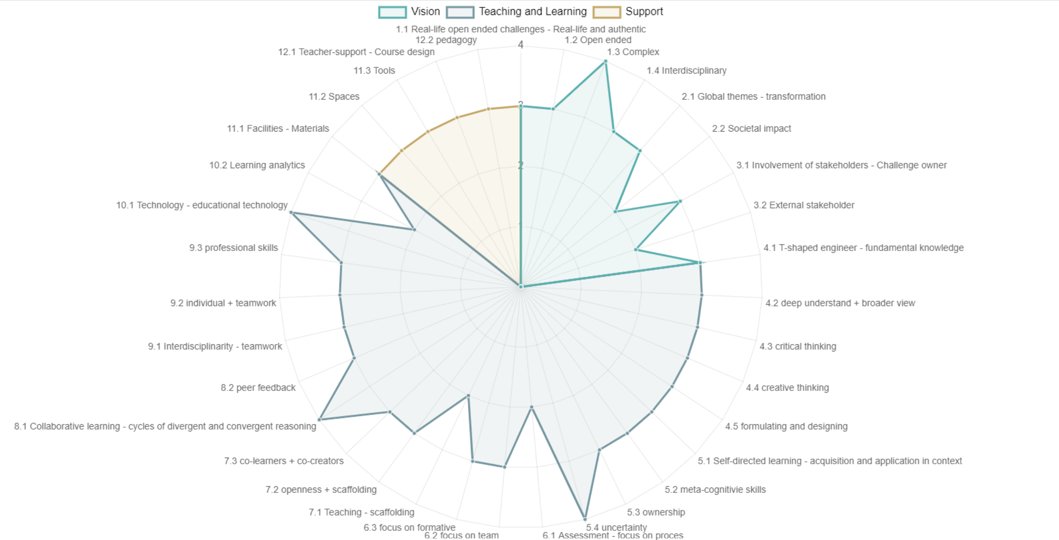
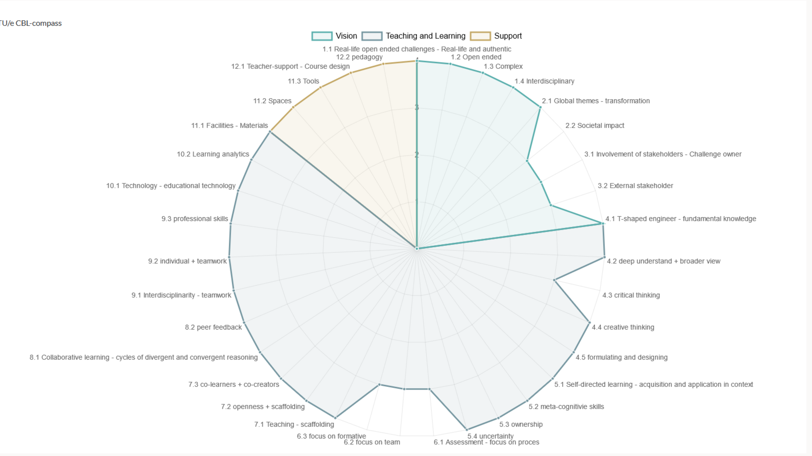
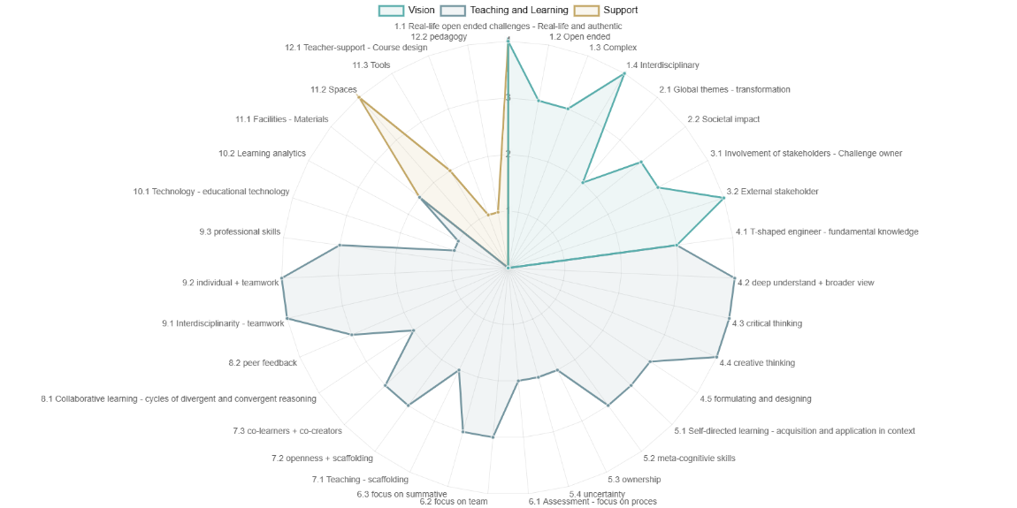
Results: Teacher’s Intentions (RQ1)
Course 1
Course 3
Course 3
Course 2
Course 4

Slide 14
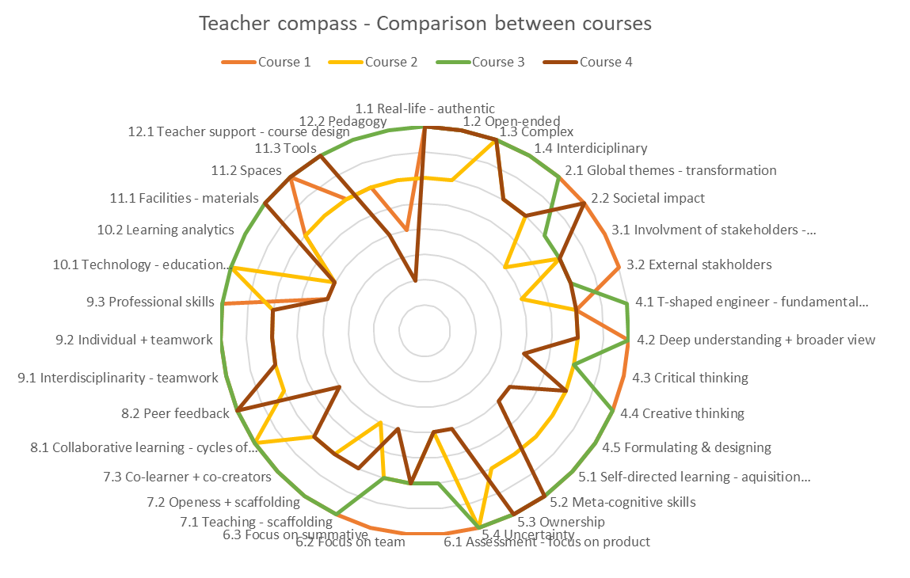
Results: Teacher's Intentions (RQ1)
Differences in intended implementation
Vision:
Societal impact (2.2)
External stakeholders (3.1)
Teaching and learning:
Self-directed learning – acquisition & application in the context (5.1)
Assessment – Focus on product (6.1)
Assessment – Focus on team (6.2)
Teaching Scaffolding (7.1)
Collaborative learning - Cycles of divergent & convergent reasoning (8.1)
Support:
Technology - Education technology (10.1)
Learning analytics (10.2)
Teacher support - course design (12.1)
Teacher support – Pedagogy (12.2)

Slide 15
Results: Teacher’s Intentions (R1)
RQ 1: Implementation intended by the teacher (Teacher interviews)
Collider as a joint educational concept with joint theme, agreements on challenge design, stakeholder involvement
Fewer differences in the implementation of CBL in the indicators of Vision
Lecturers set individual priorities in the design of the course and are partly limited by the examination guidelines
Higher differences in the teaching and learning section
Universities differ in their support structures for teachers and IT resources for teaching
Higher differences in support

Slide 16
Results: Students Percetions and Comparison (RQ2 & RQ3)
Indicator | Course 1 |  |  | Course 2 |  |  | Course 3 |  |  | Course 4
 | Teacher | Students |  | Teacher | Students |  | Teacher | Students |  | Teacher | Students
 |  | M | SD |  | M | SD |  | M | SD |  | M | SD
Real-life and open-ended challenges
Real-life/ Authenticity | 4 | 3.15 | .81 | 3 | 3.50 | 1.23 | 4 | 3.56 | .53 | 4 | 3.73 |  | .67
Open-endedness | 4 | 3.00 | 1.08 | 3 | 3.67 | .52 | 4 | 3.76 | .50 | 4 | 3.46 |  | .58
Complexity | 4 | 2.77 | .83 | 4 | 2.50 | 1.00 | 4 | 3.56 | .53 | 4 | 3.31 |  | .84
Interdisciplinarity | 4 | 3.08 | .76 | 3 | 3.67 | .52 | 4 | 3.33 | .71 | 3 | 3.62 |  | .50
Global themes
Long-term societal impact | 4 | 3.00 | 1.00 | 2 | 3.50 | .55 | 3 | 3.56 | .73 | 4 | 3.62 |  | .57
Collaboration with stakeholders
Challenge-owner | 4 | 2.97 | 1.04 | 3 | 2.50 | 1.05 | 3 | 3.67 | .50 | 3 | 3.69 |  | .55
External stakeholders | 4 | 2.77 | .60 | 2 | 3.33 | .82 | 3 | 3.22 | .67 | 3 | 3.50 |  | .51
Assessment - Balance
Product - process | 4 | 3.23 | .60 | 2 | 3.17 | .41 | 3 | 3.11 | .33 | 2 | 3.42 |  | .50
Individual - team | 4 | 3.08 | .76 | 3 | 3.33 | .52 | 3 | 2.67 | 1.23 | 3 | 3.42 |  | .64
Formative - summative | 4 | 3.00 | .58 | 3 | 3.00 | .00 | 4 | 3.33 | .87 | 2 | 3.50 |  | .51
Interdisciplinarity
Interdisciplinary teamwork | 4 | 3.38 | .65 | 3 | 3.17 | .41 | 4 | 3.33 | .87 | 3 | 3.58 |  | .50
Combinations of individual and teamwork | 4 | 3.33 | .63 | 3 | 3.50 | .55 | 4 | 3.44 | .53 | 3 | 3.65 |  | .49
Notes. Teachers Compass: Min. 1, Max 4; Students Compass: Min. 1; Max 4 (1=strongly disagree; 2=disagree; 3=agree; 4=strongly agree)

Slide 17
Results: Students Perceptions (RQ2)
RQ2: Comparison of students responses between courses
Indicator | Course 1 |  |  | Course 2 |  |  | Course 3 |  |  | Course 4
 | Teacher | Students |  | Teacher | Students |  | Teacher | Students |  | Teacher | Students
 |  | M | SD |  | M | SD |  | M | SD |  | M |  | SD
Real-life and open-ended challenges
Real-life/ Authenticity | 4 | 3.15 | .81 | 3 | 3.50 | 1.23 | 4 | 3.56 | .53 | 4 | 3.73 | .67
Open-endedness | 4 | 3.00 | 1.08 | 3 | 3.67 | .52 | 4 | 3.76 | .50 | 4 | 3.46 | .58
Complexity | 4 | 2.77 | .83 | 4 | 2.50 | 1.00 | 4 | 3.56 | .53 | 4 | 3.31 | .84
Interdisciplinarity | 4 | 3.08 | .76 | 3 | 3.67 | .52 | 4 | 3.33 | .71 | 3 | 3.62 | .50
Global themes
Long-term societal impact | 4 | 3.00 | 1.00 | 2 | 3.50 | .55 | 3 | 3.56 | .73 | 4 | 3.62 | .57
Collaboration with stakeholders
Challenge-owner | 4 | 2.97 | 1.04 | 3 | 2.50 | 1.05 | 3 | 3.67 | .50 | 3 | 3.69 | .55
External stakeholders | 4 | 2.77 | .60 | 2 | 3.33 | .82 | 3 | 3.22 | .67 | 3 | 3.50 | .51
Assessment - Balance
Product - process | 4 | 3.23 | .60 | 2 | 3.17 | .41 | 3 | 3.11 | .33 | 2 | 3.42 | .50
Individual - team | 4 | 3.08 | .76 | 3 | 3.33 | .52 | 3 | 2.67 | 1.23 | 3 | 3.42 | .64
Formative - summative | 4 | 3.00 | .58 | 3 | 3.00 | .00 | 4 | 3.33 | .87 | 2 | 3.50 | .51
Interdisciplinarity
Interdisciplinary teamwork | 4 | 3.38 | .65 | 3 | 3.17 | .41 | 4 | 3.33 | .87 | 3 | 3.58 | .50
Combinations of individual and teamwork | 4 | 3.33 | .63 | 3 | 3.50 | .55 | 4 | 3.44 | .53 | 3 | 3.65 | .49
Notes. Teachers Compass: Min. 1, Max 4; Students Compass: Min. 1; Max 4 (1=strongly disagree; 2=disagree; 3=agree; 4=strongly agree)

Slide 18
Results: Students Perceptions (RQ2)
RQ 2: Implementation perceived by students
Indicators perceived as less implemented by the students
  In comparison to other indicators (e.g. real-life and authentic challenges) some in some indicators in regard to complexity, stakeholder involvement and assessment seams to be fewer implemented
Higher differences between courses are shown for
  Differences in challenges and involvement of external stakeholders depending on availability of external stakeholders and the ecosystem of the universities
.
Complexity
External stakeholders
Balance between individual and team assessment
Course 2 and 3
Course 1
  Course 3
Open-endedness
Long-term societal
Involvement of external stakeholders
Course 1
Course 1
  All Courses

Slide 19
Results: Frictions (RQ3)
Indicator | Course 1 |  |  | Course 2 |  |  | Course 3 |  |  | Course 4
 | Teacher | Students |  | Teacher | Students |  | Teacher | Students |  | Teacher | Students
 |  | M | SD |  | M | SD |  | M | SD |  | M | SD
Real-life and open-ended challenges
Real-life/ Authenticity | 4 | 3.15 | .81 | 3 | 3.50 | 1.23 | 4 | 3.56 | .53 | 4 | 3.73 |  | .67
Open-endedness | 4 | 3.00 | 1.08 | 3 | 3.67 | .52 | 4 | 3.76 | .50 | 4 | 3.46 |  | .58
Complexity | 4 | 2.77 | .83 | 4 | 2.50 | 1.00 | 4 | 3.56 | .53 | 4 | 3.31 |  | .84
Interdisciplinarity | 4 | 3.08 | .76 | 3 | 3.67 | .52 | 4 | 3.33 | .71 | 3 | 3.62 |  | .50
Global themes
Long-term societal impact | 4 | 3.00 | 1.00 | 2 | 3.50 | .55 | 3 | 3.56 | .73 | 4 | 3.62 |  | .57
Collaboration with stakeholders
Challenge-owner | 4 | 2.97 | 1.04 | 3 | 2.50 | 1.05 | 3 | 3.67 | .50 | 3 | 3.69 |  | .55
External stakeholders | 4 | 2.77 | .60 | 2 | 3.33 | .82 | 3 | 3.22 | .67 | 3 | 3.50 |  | .51
Assessment - Balance
Product - process | 4 | 3.23 | .60 | 2 | 3.17 | .41 | 3 | 3.11 | .33 | 2 | 3.42 |  | .50
Individual - team | 4 | 3.08 | .76 | 3 | 3.33 | .52 | 3 | 2.67 | 1.23 | 3 | 3.42 |  | .64
Formative - summative | 4 | 3.00 | .58 | 3 | 3.00 | .00 | 4 | 3.33 | .87 | 2 | 3.50 |  | .51
Interdisciplinarity
Interdisciplinary teamwork | 4 | 3.38 | .65 | 3 | 3.17 | .41 | 4 | 3.33 | .87 | 3 | 3.58 |  | .50
Combinations of individual and teamwork | 4 | 3.33 | .63 | 3 | 3.50 | .55 | 4 | 3.44 | .53 | 3 | 3.65 |  | .49
Notes. Teachers Compass: Min. 1, Max 4; Students Compass: Min. 1; Max 4 (1=strongly disagree; 2=disagree; 3=agree; 4=strongly agree)
RQ3: Higher standard deviation within courses

Slide 20
Results: Convergence and Frictions (RQ3)
Indicator | Course 1 |  |  | Course 2 |  |  | Course 3 |  |  | Course 4
 | Teacher | Students |  | Teacher | Students |  | Teacher | Students |  | Teacher | Students
 |  | M | SD |  | M | SD |  | M | SD |  | M | SD
Real-life and open-ended challenges
Real-life/ Authenticity | 4 | 3.15 | .81 | 3 | 3.50 | 1.23 | 4 | 3.56 | .53 | 4 | 3.73 |  | .67
Open-endedness | 4 | 3.00 | 1.08 | 3 | 3.67 | .52 | 4 | 3.76 | .50 | 4 | 3.46 |  | .58
Complexity | 4 | 2.77 | .83 | 4 | 2.50 | 1.00 | 4 | 3.56 | .53 | 4 | 3.31 |  | .84
Interdisciplinarity | 4 | 3.08 | .76 | 3 | 3.67 | .52 | 4 | 3.33 | .71 | 3 | 3.62 |  | .50
Global themes
Long-term societal impact | 4 | 3.00 | 1.00 | 2 | 3.50 | .55 | 3 | 3.56 | .73 | 4 | 3.62 |  | .57
Collaboration with stakeholders
Challenge-owner | 4 | 2.97 | 1.04 | 3 | 2.50 | 1.05 | 3 | 3.67 | .50 | 3 | 3.69 |  | .55
External stakeholders | 4 | 2.77 | .60 | 2 | 3.33 | .82 | 3 | 3.22 | .67 | 3 | 3.50 |  | .51
Assessment - Balance
Product - process | 4 | 3.23 | .60 | 2 | 3.17 | .41 | 3 | 3.11 | .33 | 2 | 3.42 |  | .50
Individual - team | 4 | 3.08 | .76 | 3 | 3.33 | .52 | 3 | 2.67 | 1.23 | 3 | 3.42 |  | .64
Formative - summative | 4 | 3.00 | .58 | 3 | 3.00 | .00 | 4 | 3.33 | .87 | 2 | 3.50 |  | .51
Interdisciplinarity
Interdisciplinary teamwork | 4 | 3.38 | .65 | 3 | 3.17 | .41 | 4 | 3.33 | .87 | 3 | 3.58 |  | .50
Combinations of individual and teamwork | 4 | 3.33 | .63 | 3 | 3.50 | .55 | 4 | 3.44 | .53 | 3 | 3.65 |  | .49
Notes. Teachers Compass: Min. 1, Max 4; Students Compass: Min. 1; Max 4 (1=strongly disagree; 2=disagree; 3=agree; 4=strongly agree)
RQ3: Friction between teachers and students' evaluation

Slide 21
Results: Convergence and Frictions (RQ3)
RQ 3: Convergence and friction
Higher standard deviation for authenticity of challenge (course 2), open-endedness (course 1), complexity (course 2), long term societal impact (course 1) and individual and team assessment (course 3)
Friction from teachers' intentions and students' perception in
Overall, high convergence between students and teachers' answers
  Different challenges within the courses → Implementation might vary between challenges
  In the middle of the course, students still lack the experience to evaluate the assessment
  Assessment of the complexity of the challenge may also depend on personal dispositions
Complexity of the challenge
Long term societal impact
Assessment – Balance between product and process
Assessment – Balance between formative and summative assessment
Course 1 and 2
Course 2
Course 2
Course 4

Slide 22
Discussion & Implications
From high convergence it can be deduced that teachers and students perceive the learning environment and the implementation mostly in a comparable way
  Further research might analyze the effects of convergence and friction for student motivation, engagement and performance (Königs et al., 2014)
  CBL compass tool as suitable way describe implementation of the courses
Variety in intentions for implementation strengthens the relevance to map implementation (van de Beemt et al., 2023)
  Future research might connect different ways of implementation to student learning and outcome measures
Limitations:
  Response rate in students' surveys
  Quality (reliability) of teacher evaluations (only one rating in the beginning of the course)
  Differences from intentions and real implementation when the course started
  Different complexity and open-endedness within the same course and different challenges

Slide 23
Practical Implications
Practical implications:
Implications for EuroTeQ Collider
  Transparent communication of assessment strategies between students and faculty
  Sharing of resources for teacher support e.g., expertise, materials, mentoring
  Reflect on complexity of the challenge and involvement of external stakeholders
General practical implications
The CBL-compass tool can be used to map implementation of the course
  Starting point for discussion between teachers, students and support structures
  Inspiration and implications for further development of CBL courses
  Data-driven reflection of the learning environment

Slide 24
References
Bombaerts, G., Doulougeri, K., Tsui, S., Laes, E., Spahn, A., & Martin, D. A. (2021). Engineering students as co-creators in an ethics of technology course. Science and Engineering Ethics, 27(4). https://doi.org/10.1007/s11948-021-00326-5
Den Brok, P. J., Bergen, T. C. M., & Brekelmans, J. M. G. (2006). Convergence and divergence between students’ and teachers’ perceptions of instructional behaviour in Dutch secondary education. In D. L. Fisher & M. S. Khine (Eds.), Contemporary approaches to research on learning environments: World views (pp. 125–160). Singapore: World Scientific. https://doi.org/10.1142/9789812774651_0006
Dochy, F., Segers, M., Van Den Bossche, P., & Gijbels, D. (2003). Effects of problem-based learning: A meta-analysis. Learning and Instruction, 13(5), 533–568. https://doi.org/10.1016/s0959-4752(02)00025-7
Doppelt, Y. (2004). Impact of science-technology learning environment characteristics on learning outcomes: Pupils’ perceptions and gender differences. Learning Environments Research, 7, 271-293. https://doi.org/10.1007/s10984-004-3297-4
Doulougeri, K., Vermunt, J. D., Bombaerts, G., Bots, M., & de Lange, R. (2021). How do students regulate their learning in challenge-based learning? An analysis of students’ learning portfolios. In H-U. Heiß, H-M. Järvinen, A. Mayer, & A. Schulz (Eds.), Proceedings - SEFI 49th Annual Conference: Blended Learning in Engineering Education: Challenging, Enlightening - and Lasting? (pp. 204-216). Technische Universität Berlin. https://www.sefi.be/wp-content/uploads/2021/12/SEFI49th-Proceedings-final.pdf
Gallagher, S. E., & Savage, T. (2020). Challenge-based learning in higher education: An exploratory literature review. Teaching in Higher Education, 1–23. https://doi.org/10.1080/13562517.2020.1863354
Könings, K. D., Seidel, T., Brand-Gruwel, S., & Van Merriënboer, J. J. G. (2013). Differences between students’ and teachers’ perceptions of education: Profiles to describe congruence and friction. Instructional Science, 42(1), 11–30. https://doi.org/10.1007/s11251-013-9294-1
Leijon, M., Gudmundsson, P., Staaf, P., & Christersson, C. (2021). Challenge based learning in higher education– A systematic literature review. Innovations in Education and Teaching International, 59(5), 609–618. https://doi.org/10.1080/14703297.2021.1892503
Malmqvist, J., Rådberg, K. K., & Lundqvist, U. (2015). Comparative analysis of challenge-based learning experiences. In Proceedings of the 11th International CDIO Conference, Chengdu University of Information Technology, Chengdu, Sichuan, PR China (Vol. 8, pp. 87-94). https://research.chalmers.se/en/publication/218615
Nichols, M., Cator, K., Torres, M., & Henderson, D. (2016). Challenge based learner user guide. Redwood city, CA: Digital promise.
Gómez Puente, S. M., van Eijck, M., & Jochems, W. (2013). Facilitating the learning process in design-based learning practices: An investigation of teachers' actions in supervising students. Research in Science & Technological Education, 31(3), 288-307. https://doi.org/10.1080/02635143.2013.837043
Van Den Beemt, A., MacLeod, M. A. J., Van Der Veen, J., Van De Ven, A., Van Baalen, S., Klaassen, R., & Boon, M. (2020). Interdisciplinary engineering education: A review of vision, teaching, and support. Journal of Engineering Education, 109(3), 508–555. https://doi.org/10.1002/jee.20347
Van Den Beemt, A., Van De Watering, G., & Bots, M. (2022). Conceptualising variety in challenge-based learning in higher education: The CBL-compass. European Journal of Engineering Education, 48(1), 24–41. https://doi.org/10.1080/03043797.2022.2078181
Van Den Beemt, A., Van De Watering, G., & Bots, M. (2021). Variety in challenge-based learning in higher education. In H-U. Heiss, H-M. Jarvinen, A. Mayer, & A. Schulz (Eds.), Proceedings - SEFI 49th Annual Conference: Blended Learning in Engineering Education: Challenging, Enlightening - and Lasting? (pp. 598-609). European Society for Engineering Education (SEFI). https://www.sefi.be/wp-content/uploads/2021/12/SEFI-Annual-Conference-2021-Blended-Learning-in-Engineering-Education.pdf
Vermunt, J. D., & Verloop, N. (1999). Congruence and friction between learning and teaching. Learning and instruction, 9(3), 257-280. https://doi.org/10.1016/S0959-4752(98)00028-0
Watkins, D. (2004). Teachers as scholars of their students' conceptions of learning: A Hong Kong investigation. British Journal of Educational Psychology, 74(3), 361-373. https://doi.org/10.1348/0007099041552332

Slide 25


EuroTeQ Engineering University
CBL Compass Tool
Thank you for your attention!
Contacts:
selina.michel@tum.de

